Slide 1



ABC: Adaptive Beacon Control for Rear-End Collision Avoidance in VANETs
Feng Lyu, Hongzi Zhu, Minglu Li
Date: Jun 13, 2018
Dept. of Computer Science & Engineering, Shanghai Jiao Tong University

Slide 2
Outline
Background and Motivation
System Model
Simulation Setup & Evaluation
ABC Protocole Design
Collision-Avoidance Beacon Rate Control

Slide 3
Modern Transportation Challenges
Safety：Global road traffic crashes accounts for
1.2 million deaths/year since 2007
Top the causes of death for ages 15-29
3% of GDP loss for low/middle-income countries
Mobility: In 2015, US
Commuters wasted 8 billion hours in traffic
$160 billion cost of urban congestion
Environment: In 2014, US
Wasted fuel topped 3 billion gallons
56 billion lbs. of additional CO2

Slide 4
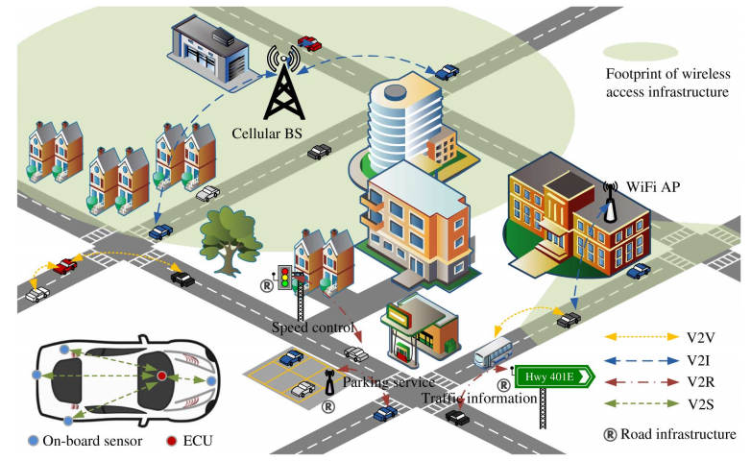
V2X-Enabled Intelligent Transportation Systems

Slide 5
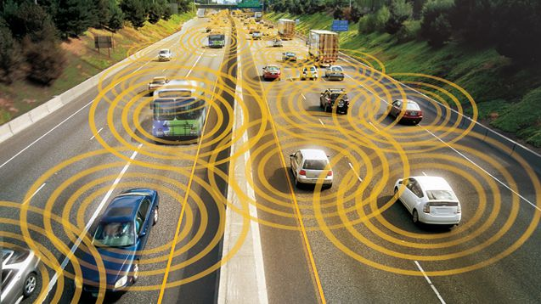
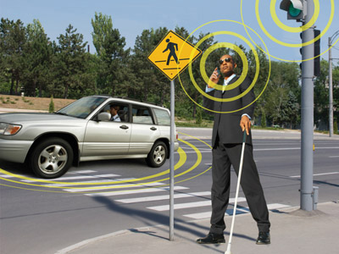
Real-Time Beacon Exchange by Broadcasting
Vehicle: position, velocity, heading direction, acceleration or turn signal status.
RSU: traffic signal status, road surface type, weather conditions, speed limits or the current traffic conditions.
Safety applications: pre-crash sensing, lane Change Warning, blind spot warning, emergency electronic brake lights, and cooperative forward collision avoidance.

Slide 6
Challenges of Widely Employing Broadcasting
Given the limited available bandwidth for V2X communications, how to guarantee the safety requirement of each vehicle, especially for dense traffic scenarios, is not trivial:
aggressive beaconing rates make some vehicles have no required bandwidth (channel congested);
moderate beaconing rates make the status of neighboring vehicles may be out-of-date.
The lack of a global central unit in VANETs makes an optimal beaconing scheme very hard to achieve.
Due to the high mobility of vehicles and fast changing environments, the distributed beaconing scheme should minimize the communication overhead and react fast to keep the pace.
Goal: Adaptively control beacon rates with safety-awareness

Slide 7
System Model-DSRC
The Dedicated Short Range Communication (DSRC) is a standard customised for highly mobile, severe-fading vehicular environments;
5.700 to 5.925 GHz frequencies;
One control channel and multiple service channels with two optional bandwidths of 10 MHz and 20 MHz;
Communication range 0-1000 m;
Data rates 0-54 Mbps;

Slide 8
System Model-TDMA-Based Broadcast MAC
Weaknesses of 802.11p for supporting periodical broadcast :
the basic MAC method of 802.11p is contention-based, which may result in possible unbounded delays;
in broadcast mode of 802.11p protocol, RTS/CTS packets are removed to facilitate real-time response, which leaves the hidden terminal problem unsolved.
Start of a GPS second
Start of a GPS second
Frame 1
Frame 2
The slotted channel can guarantee the stringent time requirement of safety-related applications.
[1] H. A. Omar, W. Zhuang, and L. Li, “VeMAC: A TDMA-Based MAC Protocol for Reliable Broadcast in VANETs,” IEEE Transactions on Mobile Computing, vol. 12, no. 9, pp. 1724–1736, Jun. 2013.

Slide 9
Beacon Starving Problem
Neighboring vehicles within the communication range of a vehicle constitute the one-hop set (OHS) of this vehicle.
If two OHSs overlap with each other, the union of these two OHSs is referred to as a two-hop set (THS).
The number of slots in each frame is far from enough to support high density scenarios.

Slide 10
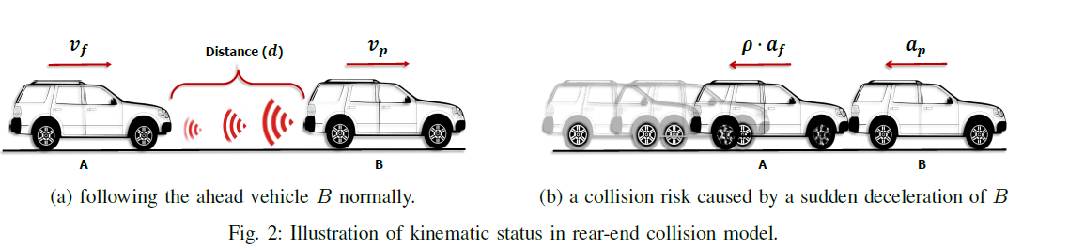
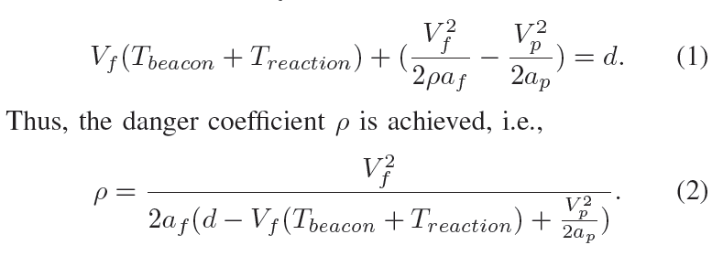
Collision-Avoidance Beacon Rate Control
Definition 1: (Danger coefficient 𝛒 ) Considering two vehicles A and B move in the same lane and A is the following vehicle while B is the preceding vehicle, if vehicle B decelerates suddenly with the maximum acceleration, after knowing the situation, vehicle A has to take 𝛒 (𝛒 in (0,1]) times of its maximum acceleration to brake to avoid a collision with B. Then, vehicle B is said to be dangerous with a coefficient 𝛒 in terms of encountering a rear-end collision.

Slide 11
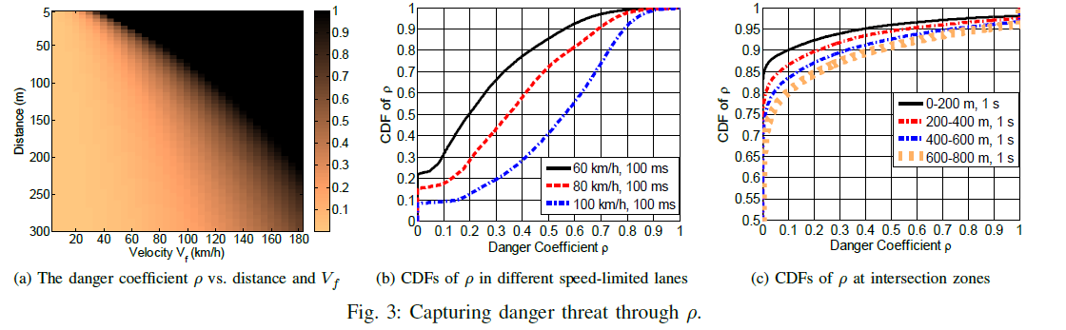
Capturing Danger Threat

Slide 12
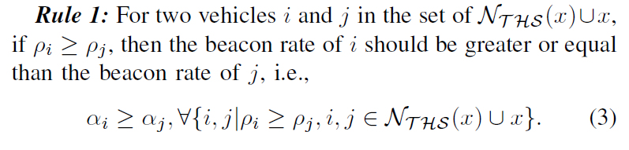
𝛒-Based Beacon Rate Adaptation

Slide 13
ABC Protocol Design-Overview
online congestion detection
distributed beacon rate adapting
adapting results informing
modeling of beacon resource
NP-hard problem
fast convergence

Slide 14
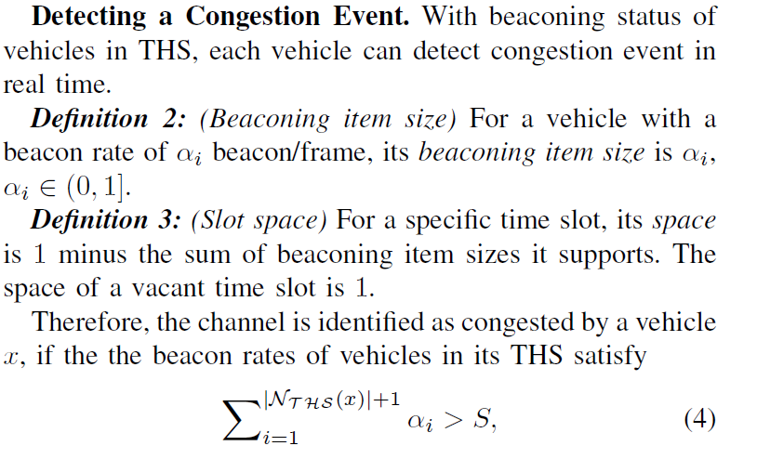
ABC: Online Congestion Detection
Collecting beaconing status:
Each vehicle including (𝜶, 𝛒) list information of itself and its OHS neighbors in every beacon;
Perceiving and updating beaconing status of vehicles in its own THS by receiving beacons;
Detecting a congestion event:

Slide 15
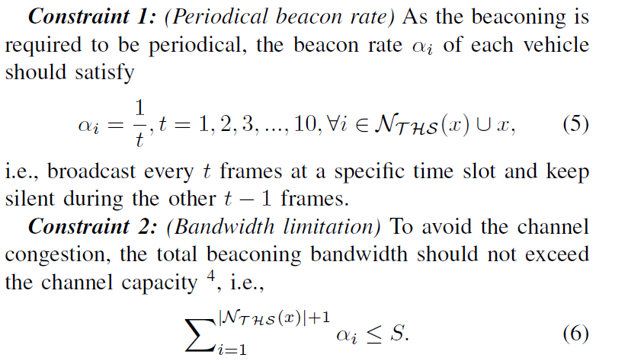

ABC: Distributed Beacon Rate Adapting (DBRA)
Safety-Weighted Network Utility Maximization:

Slide 16
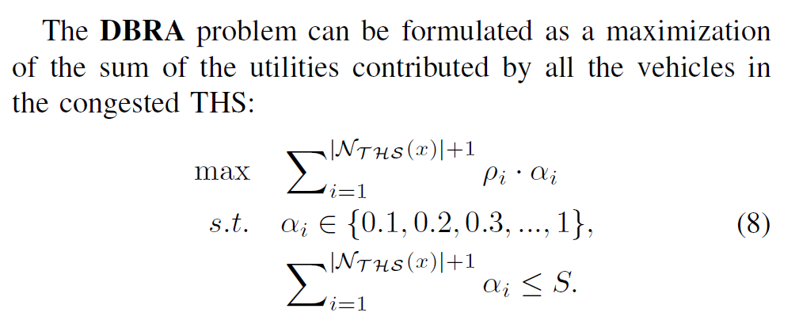
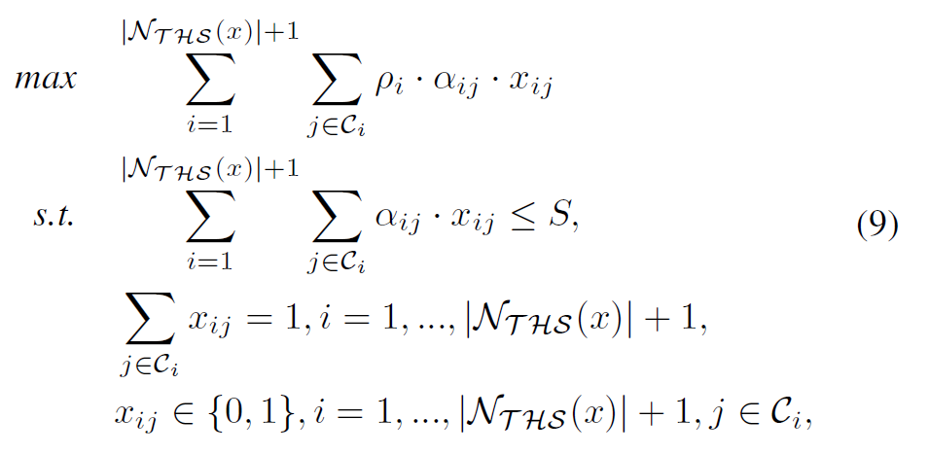
ABC: Distributed Beacon Rate Adapting (DBRA)

Slide 17
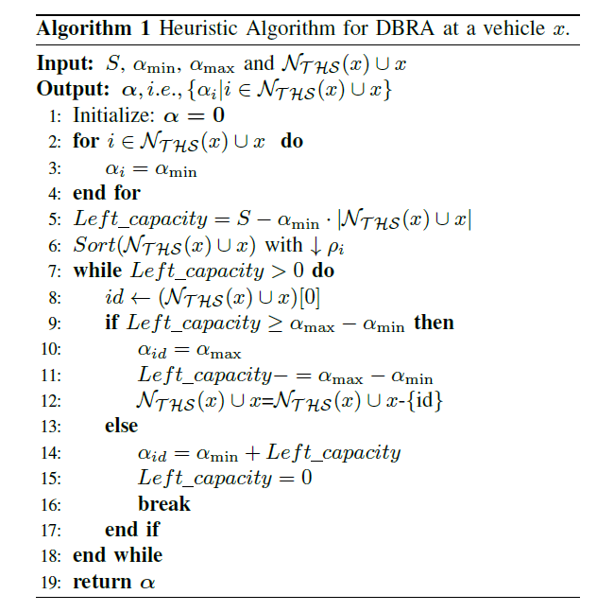
ABC: Distributed Beacon Rate Adapting (DBRA)

Slide 18
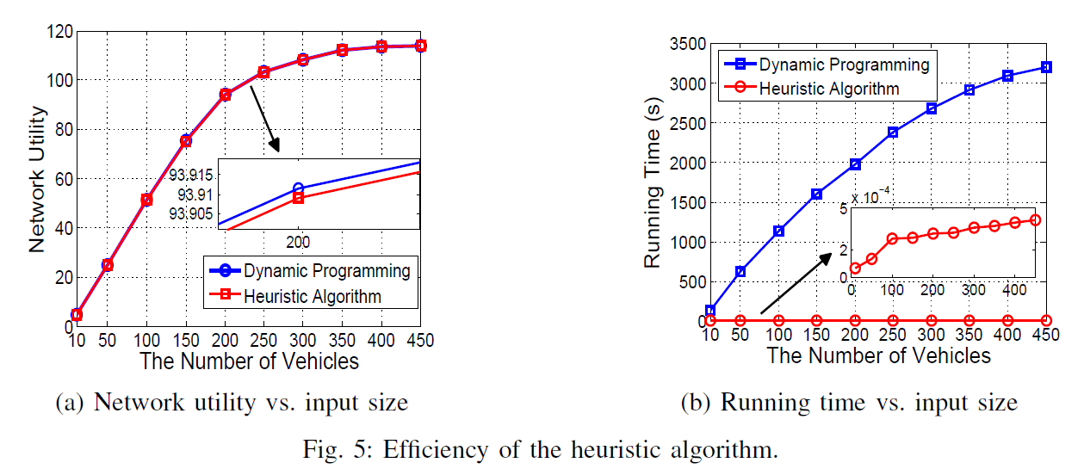
ABC: Distributed Beacon Rate Adapting (DBRA)

Slide 19
ABC: Adapting Results Informing
Comparing the beaconing rate between DBRA results and the beaconing status of each vehicle in its THS;
including the information (vehicle ID, assigned beacon rate) of those vehicles, whose current beacon rate is larger than the results assigned by DBRA, in its next beacon and broadcast to its neighbors;
Once a neighbor receives the informing beacon, it will compare its own beacon rate with the assigned result and adjust its beacon rate if necessary.

Slide 20
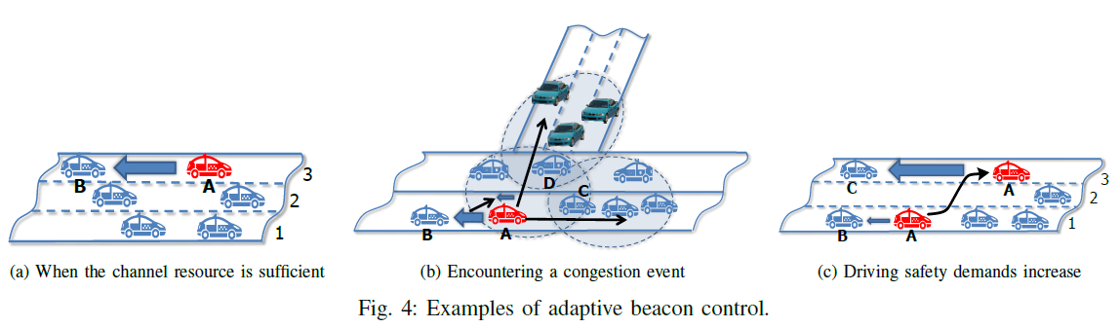
ABC: Adaptive Beacon Control Approach
vehicles can normally broadcast at the maximum beacon rate when the channel resources are enough and meanwhile keep identifying whether the channel is congested;
Once a congestion event is detected, ABC essentially solves a distributed beacon rate adapting (DBRA) problem with the greedy heuristic algorithm;
In addition, every vehicle is allowed to increase its own beacon rate independently when the driving safety demand increases in the moving.

Slide 21
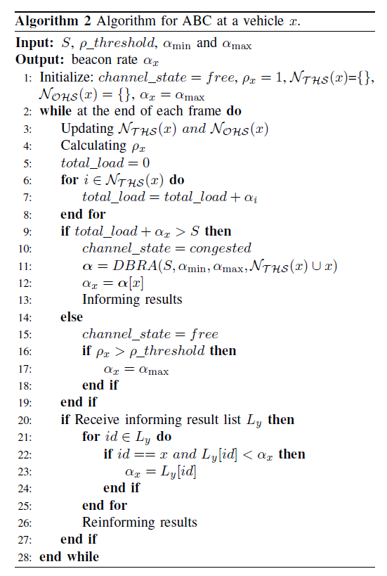
ABC: Adaptive Beacon Control Approach

Slide 22
Performance Evaluation
Candidate Schemes:
Conventional 802.11p: In broadcast mode of 802.11p protocol, each vehicle broadcasts at maximum beacon rate without any congestion control schemes;
LIMERIC: It treats all nodes equally regardless of the driving context, i.e., controlling with fairness.
Performance Metrics:
  Rate of beacon transmissions: refers to the average number of beacon transmissions per frame;
  Efficiency ratio of transmissions: refers to the number of successful transmissions to the total number of transmissions;
  Rate of beacon receptions: refers to the average number of successfully received beacons per frame;
  Rate of reception collisions: refers to the average number of reception collisions per frame happened at receivers.

Slide 23
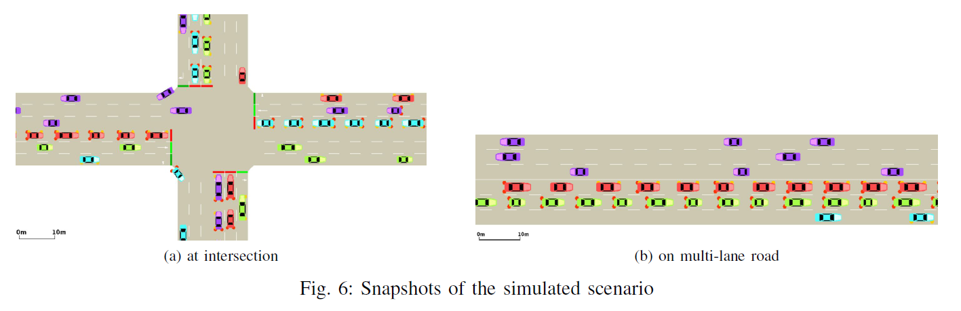
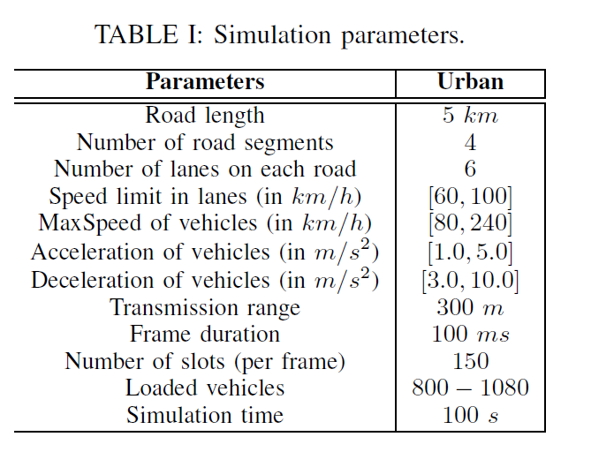
Performance Evaluation

Slide 24
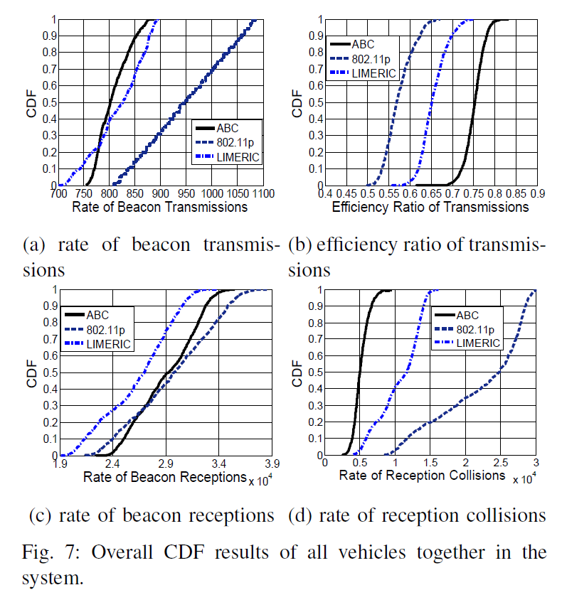
Overall Results

Slide 25
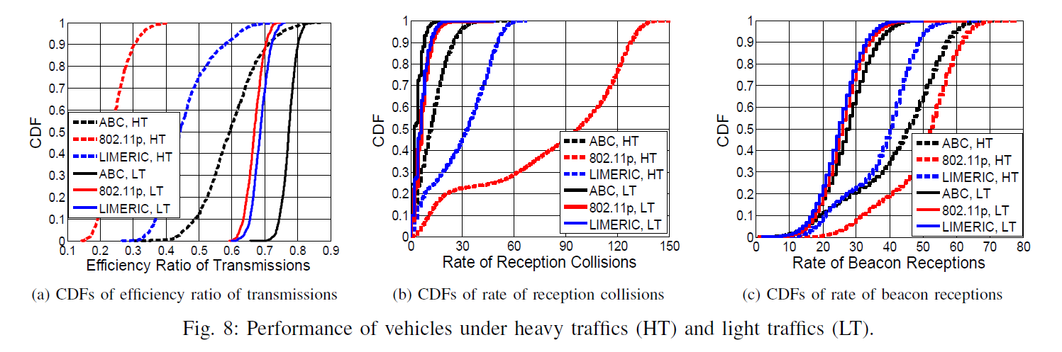
Impact of Dynamic Traffics

Slide 26
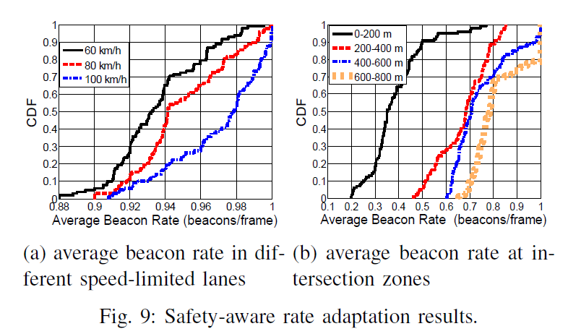
Impact of Danger Coefficient

Slide 27
Summary
We have analyzed the broadcast requirements for safety applications in VANETs and disclosed the necessary of beacon congestion control to prevent the control channel being blocked.
We have proposed a distributed adaptive beacon control scheme, called ABC, to dynamically adapt beacon rate for each vehicle, which is sufficient to avoid a rear-end collision without exceeding the capacity limit.
We have implemented the ABC scheme over SUMO-generated traces by python (with about 500 lines of code) and conducted extensive simulations to demonstrate the efficiency of ABC.

Slide 28
Questions?
Thank you!
Feng Lyu (fenglv@sjut.edu.cn)
Date: Jun 13, 2018
Shanghai Jiao Tong University

