Slide 1
Scalability of Wireless Fingerprinting based
Indoor Localization Systems
Instructor: Yingling Mao, Ke Liu, Hao Li, Instructor: Xiaohua Tian, Xinbing Wang
Institution: Shanghai Jiao Tong University
Data: aaaaaJun. 12nd, 2018
Notes:
Good afternoon, everyone!. Today I will give a talk about Scalability of Wireless Fingerprinting based Indoor Localization Systems. We are from Shanghai Jiao Tong University.

Slide 2

1
Background & Motivation
2
Problem Formulation
cont
ents
3
Main Results
4
Experimental Verification
5
Conclusion
2
Notes:
It is the outline of this talk. I will first introduce the background and motivation, then elaborate the problem formulation, after that I will present the main results and carry out the the experimental verification of our theory and conclusion.

Slide 3
1
Bcakground
3
Notes:
First, is the background

Slide 4

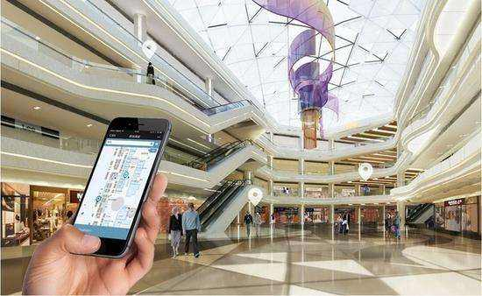
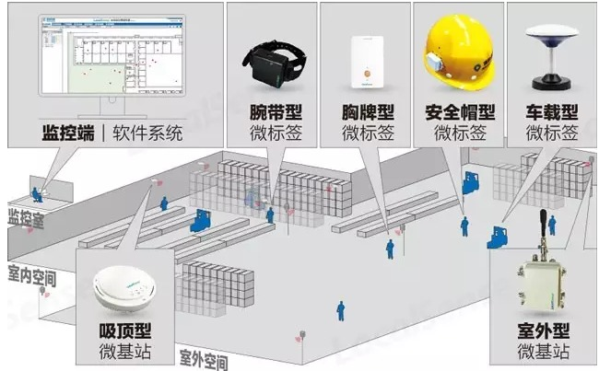
Why indoor lozalization?
Types of Transmitters:
Wrist-band
Chest card
Safety hat
Vehicle-borne
Monitoring, supervise system
R.
outdoor space
ceiling receiver
outdoor receiver
outdoor space
Smart city requirement: location information
4
Notes:
The concept of smart city makes indoor localization motivated. As the picture show, indoor localization can not only benefit users by providing many advanced applications but also can support rich supervise Systems for managers.

Slide 5
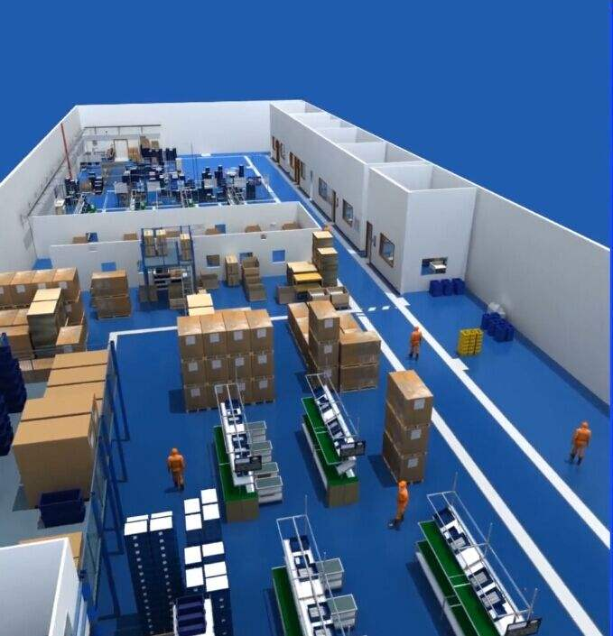
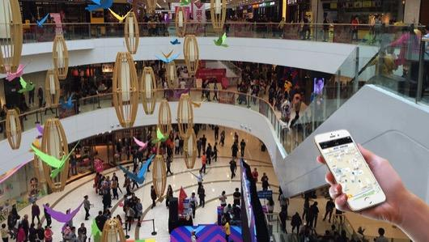
Challenges of indoor lozalization
Challenge : complex real scene
5
Notes:
However, the challenge for indoor localization is the complex real scene, such as the varied people density, the large and various space and so on.

Slide 6
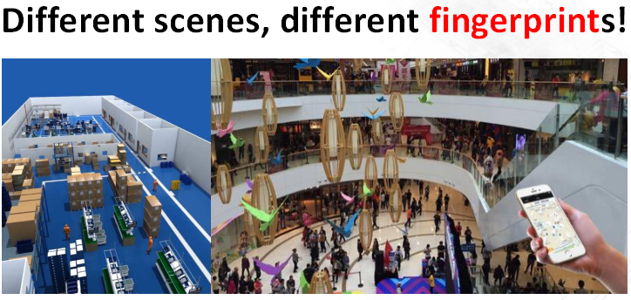
Why fingerprinting localization?
Indoor localization is still an open issue
Approach: Fingerprinting localization
6
Notes:
Due to the challenges, indoor localization is still an open issue. The fingerprint-based method can be a promising solution to overcome the above challenge as it sets up the fingerprints database depending on the real scene. Different scenes, different fingerprints! With this advantage, fingerprinting localization has been tried to applied in practice. However, its theory work is still lacking. How to evaluate finger-print method is the problem we really concern and this paper focuses on finding its theoretical limit.

Slide 7
Intro to Fingerprinting lozalization
offline phase:
Collect fingerprints in each measurement point and set up database
7
Notes:
To begin with, let me shortly introduce fingerprinting localization. It is divided into two phases——the offline phase and the online phase. For the offline phase, we can see from the picture, the mobile phone in a certain position can receive signals with different strengths from different APs and these signal strengths form an array representing this position, which we call “fingerprints”. So, the offline phase is to collect fingerprints in each measurement point, map them one-to-one and finally build the fingerprints database.

Slide 8
Intro to Fingerprinting lozalization
online phase:
Estimate user’s location by matching its RSS value with database
8
Notes:
In contrast, the online phase is to estimate user’s location by matching user’s fingerprints with fingerprints database.

Slide 9
Theory of its performance limit
accuracy & reliability:
- Q： the location of
the user
- δ： length
Q
δ
Q: What is the probability(reliability) that the user
is located in the δ (accuracy)neighborhood of Q？
9
Notes:
Then I will introduce the concept of accuracy and reliability. Usually, if the user at Q is localized in the δ neighborhood of Q, we call δ as the positioning accuracy. And the reliability is the probability that the user is located in the δ neighborhood of Q. To estimate the performance of fingerprinting method, we just need to compute the reliability with respect to the positioning accuracy.

Slide 10
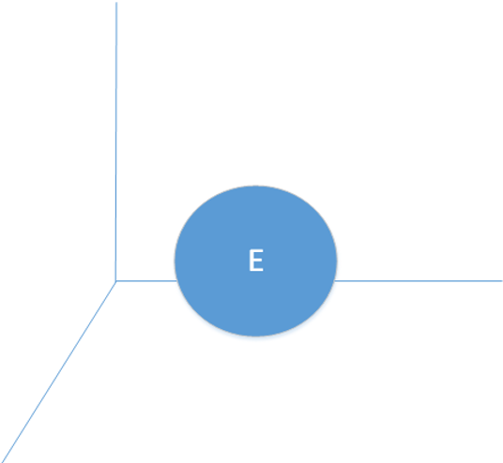



Theory of its performance limit
Mapping from sample space to physical space
_{Sample space}
_{Physical space}
10
Notes:
As we just introduced, fingerprinting method maps each data in sample space E to each position in physical space Q. Due to the definition, the reliability can be computed as shown in this formular.

Slide 11
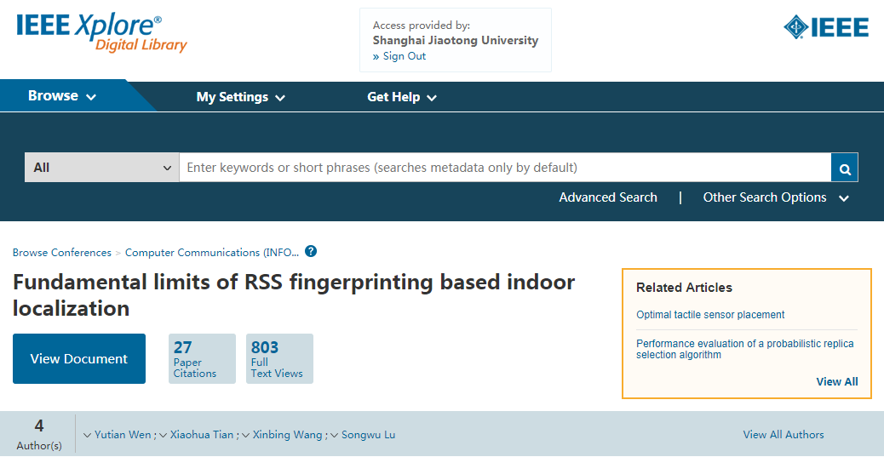
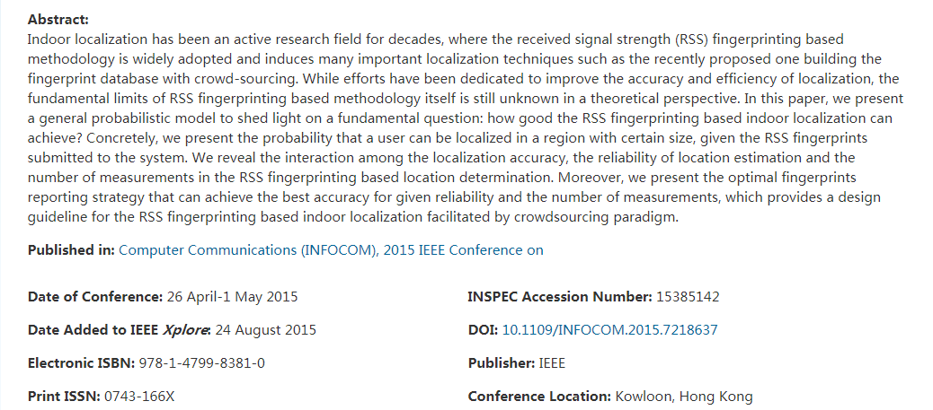
Theory of its performance limit
Fundamental Limits of RSS Fingerprinting based Indoor Localization, Infocom
11
Notes:
The formula is based on our previous work . Our group has published a paper called Fundamental Limits of RSS Fingerprinting based Indoor Localization in INFOCOM about how to compute the reliability. This paper is based on its results.

Slide 12
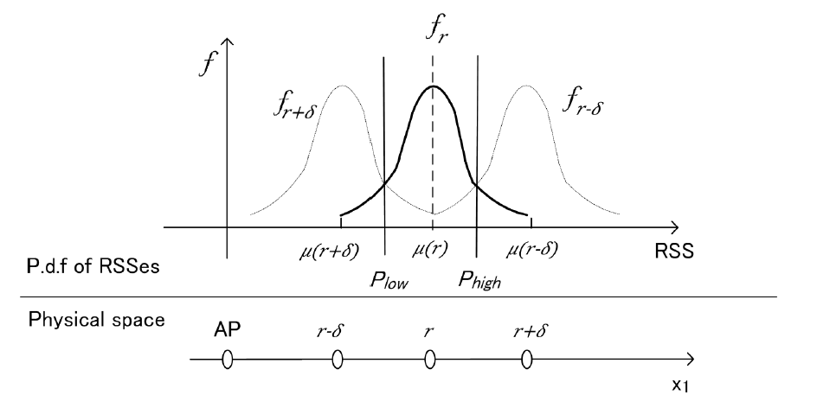
Theory of its performance limit
A
y
x
12
Notes:
I will show its main idea by this picture, which deals with a one-dimensional simple case. On the picture, the function f_r, f_{r+δ}, f_{r-δ} is the probability distribution function of the radio signal strength, shorten as RSS, value. Take f_r for example. A point A on it shows the probability that the user is located at the location r with respect to the RSS value x. And from the picture, we can know when the received RSS value is between P_low and P_high, f_r is higher than f_{r+δ} and f_{r-δ}, which means the probability that the user is located at r is highest. And that we use the probability distribution function of the position r+δ and r-δ to compare means the real position of the user is between r+δ and r-δ. So the reliability with respect to the positioning accuracy δ can be computed by integrating f_r from P_low to P_high.

Slide 13
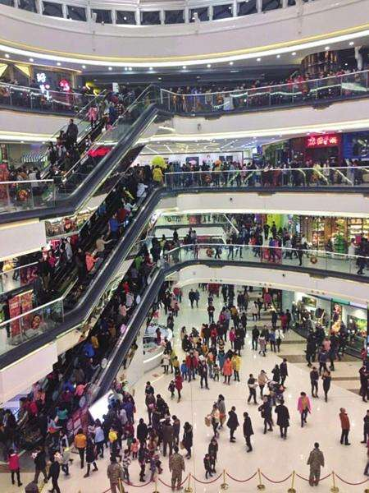
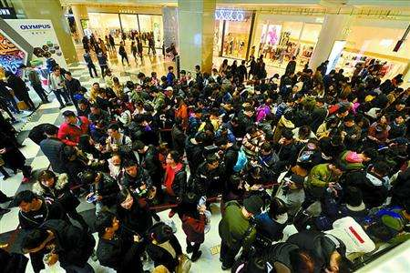

Theory of its performance limit
However
In practice,
the offline phase is NOT necessarily consistent with the online phase, especially in large malls or factories.
13
Notes:
The above computational method is based on the assumption that the online phase is consistent with or similar as the offline phase. However, in practise, the online phase is NOT necessarily consistent with the offline phase, especially in large malls or factories, because of the large amount of the people.

Slide 14
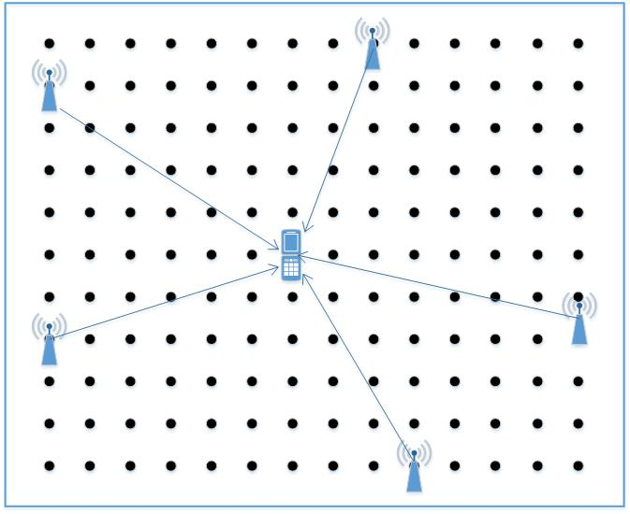
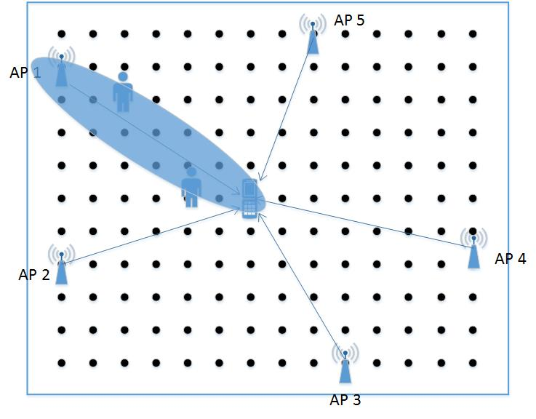
Theory of its performance limit
offline phase
online phase
Different
error
14
Notes:
In the offline phase, when we build up the database, there is no other people except the user. However, in the online phase, there exist other people in the room and they may stand between the user and the APs so that the RSS value is influenced and different from the corresponding RSS value in the offline phase. Considering the difference, there is error when computing the reliability and it must be lower. Further more, we can imagine the more people, the lower the reliability is. Our work is to compute the reliability again, taking the difference into consideration, and estimate its tendency with respect to the number of people indoor.

Slide 15
2
Problem Formulation
15
Notes:
This part, we will specifically illustrate the problem formulation of our work.

Slide 16
Problem Formulation
Compute the real reliability R'
Estimate the tendency of the reliability R' with respect to the number of users N indoor.
Two Tasks
Two tasks
16
Notes:
In order to realize our goal, we have two tasks——one is to compute the real reliability, the other is to estimate its tendency with respect to the number of users N indoor.

Slide 17
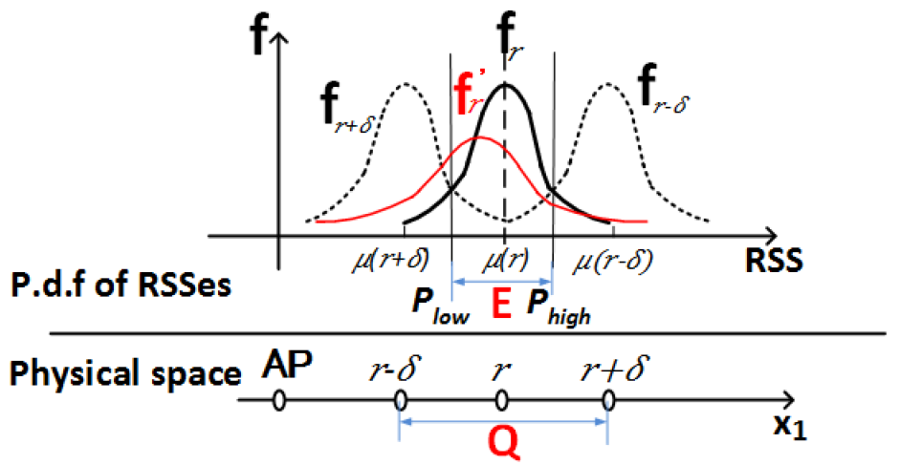
A simple example for computing reliability
Task 1:
*
Analysis: the probability distribution fun f(.) changes to f*(.), but the sample space E does NOT change.
17
Notes:
Also take a one-dimensional simple case for example. In this time, the measured probability distribution function is f_r, so the sample space is still the interval between P_low and P_high. But the real probability distribution function of RSS value in the online phase is f_r star. So considering the difference between the online phase and the offline phase, the reliability must be computed by integrating f_r star from P_low to P_high.

Slide 18
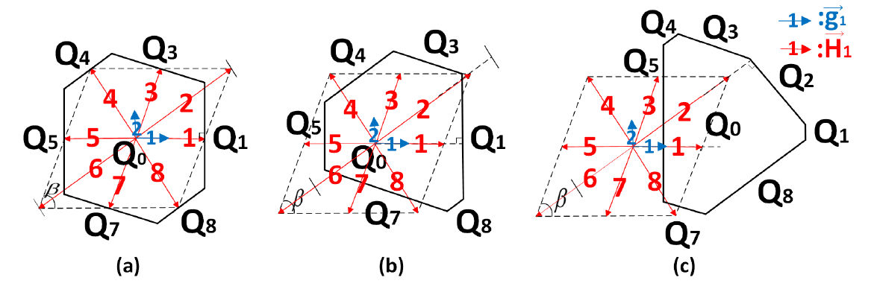
Computing the real reliability R'
Challenge 1: the difficulty of integration
Analysis: due to f*(.) and E are both complex.
Solution: We change f*(.) to the standard Gauss function by coord-inate transformation, and in this process, the sample space E changes.
18
Notes:
There are two challenges on this task. The first is the difficulty of integration, because the intersecting surface of the sample space E is like picture (a) and the f* is not standard Gauss function; both are complex. We change f* to the standard Gauss function by coordinate transformation. And in this process the sample space transforms to (b) or (c) cases. Then we do the high-dimensional integration on the transformed sample space.

Slide 19
Computing the real reliability R'
Challenge 2: Too many diff. possible real scenes
Analysis:
It is impossible to know the real distribution of users at any time in practice, which means it is impossible to know each and . So we consider the total case. We assume the users randomly walk and introduce the intermediate variable m, which means the number of all Aps whose radio signal strength is influenced by other users.
19
Notes:
The second challenge is that there are too many different possible scenes. It is impossible for us to consider each case. So we introduce the intermediate variable m, which means the number of all Apps whose radio signal strength is influenced by other users and consider the total case.

Slide 20
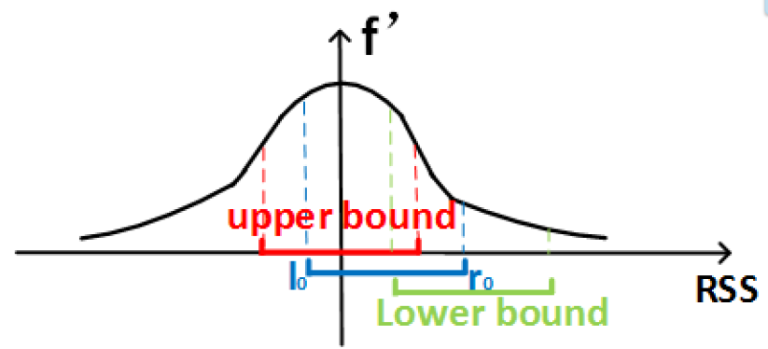
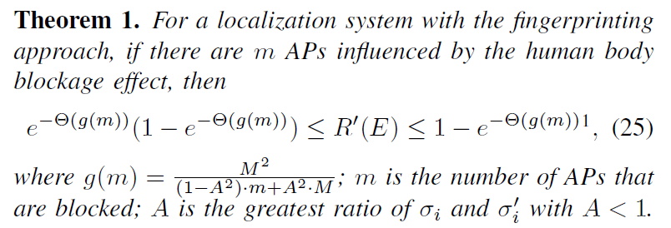
Computing the real reliability R'
Estimation of R' (~m):
20
Notes:
Combined the former two approaches, we finally get the outcome, as is shown in the slide, estimating upper bound and lower bound of the reliability

Slide 21
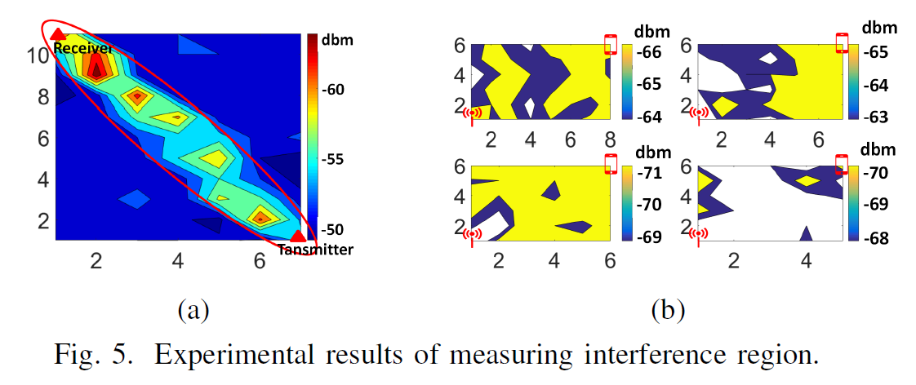
The influence of other users
Task 2:
Try ellipse model, but NOT works!
21
Notes:
To estimate the tendency of the reliability with respect to the number of users , we must find a model to evaluate the influence of other people to the RSS value. Many works in the device-free localization use ellipse model, but our experiments show this model is highly dependent on the clear environment and doesn't work in practise, especially in the noisy shopping mall with large people.

Slide 22

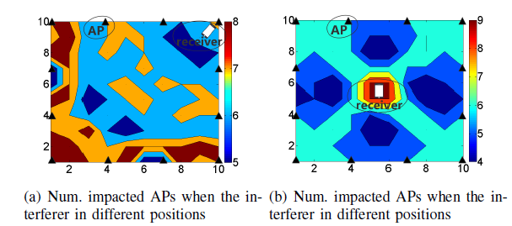
The influence of other users
Interesting finding: the number of impacted APs in the N-user case can be derived from the simple one user case, the result of which can be easily obtained with simple experiments.
22
Notes:
But we find a interesting phenomena, the number of impacted APs in the N-user case can be derived from the simple one user case, the result of which can be easily obtained with simple experiments. And in the slide, the picture (a) and (b) is examples of the result of two special one user cases.

Slide 23
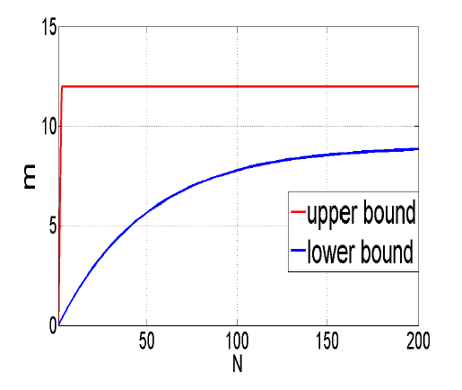
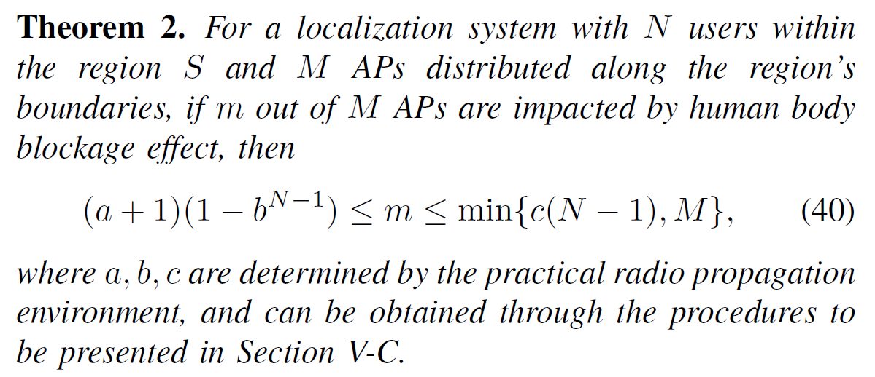
The influence of other users
m~N:
23
Notes:
Using the above method, we can estimate the relationship between the number of impacted APs and the number of people indoor, as is shown in the slide.

Slide 24
3
Main results
法、方
24

Slide 25
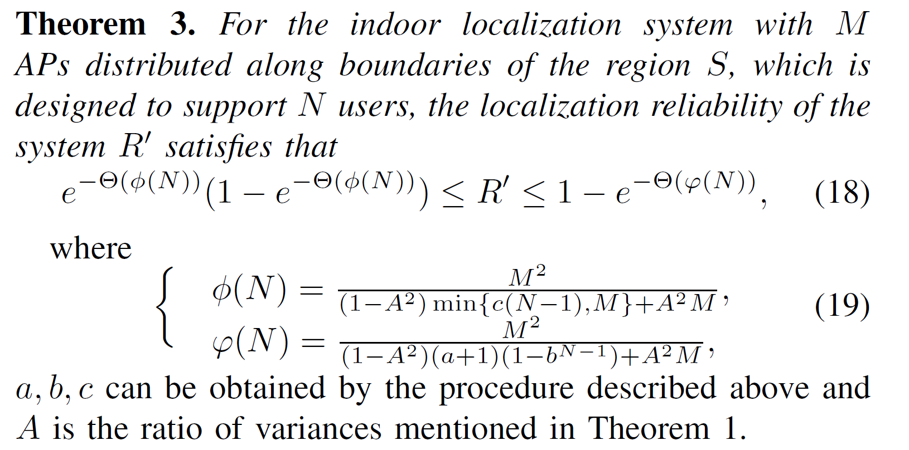
Main Results
25
Notes:
Finally, we get such main result, using the upper bound and lower bound to estimate the reliability and its tendency with respect to the number of people in the scenario.

Slide 26
4
Experimental Verfication
法、方
26

Slide 27
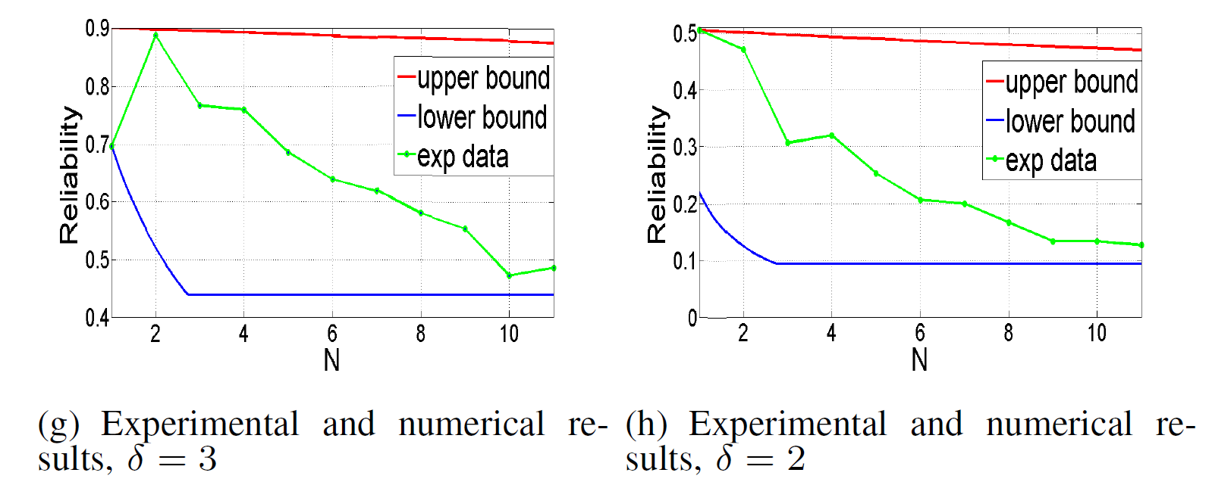
Experimental Verification
27
Notes:
And we do experiments to verify our results. The red line is the upper bound, the blue line is the lower bound, and the green line is the experimental results. The left shows the reliability with respect to the positioning accuracy 1.5m while the right shows the reliability with respect to the positioning accuracy 1m.

Slide 28
5
Conclusion
法、方
28

Slide 29
Conclusion
Localization reliability drops dramatically before the number of users increases to a critical point and then decreases smoothly, where the critical point tends to appear when the number of users equals that of APs deployed in the region.
Even if the number of users N → ∞, the fingerprinting localization system still retains certain level of reliability.
29
Notes:
We can reach such two conclusions: Localization....(on the slide); Even....(on the slide).

Slide 30

Thanks !
Further Questions Please Contact: sandglassmyl@sjtu.edu.cn

