Slide 1
COALA: Collision-Aware Link Adaptation for LTE in Unlicensed Band
Kangjin Yoon, Weiping Sun, and Sunghyun Choi
Seoul National University, Korea
June 12, 2018
Notes:
Hello, my name is Kangjin Yoon, a Ph.D. student from Seoul National University.
Today, I will talk about my recent research Collision-aware link adaptation for LTE in unlicensed band.

Slide 2
Needs for Broad Bandwidth
Licensed band
Licensed band
Data Traffic
Mobile
Unlicensed band
ISM 5 GHz
FREE
Notes:
In these days, mobile data traffic is increasing dramatically.
To address this mobile data traffic explosion, mobile network operators are eager to broaden their bandwidth.
However, buying another licensed band brings astronomical cost to them.
In that sense, utilizing unlicensed band is getting more attention of MNOs.

Slide 3
Licensed-Assisted Access (LAA)
Licensed band
3GPP Rel. 12 Carrier Aggregation
Licensed band
Unlicensed band
3GPP Rel. 13 LAA
(Licensed-Assisted Access)
FREE
Notes:
So, recently, 3GPP has finished standardization of Licensed-Assisted-Access (in short, LAA).
LAA is a variant of carrier aggregation tech. which is introduced in Rel. 12.
Unlike CA, LAA can utilize unlicensed 5 GHz spectrum as a supplemental carrier.

Slide 4
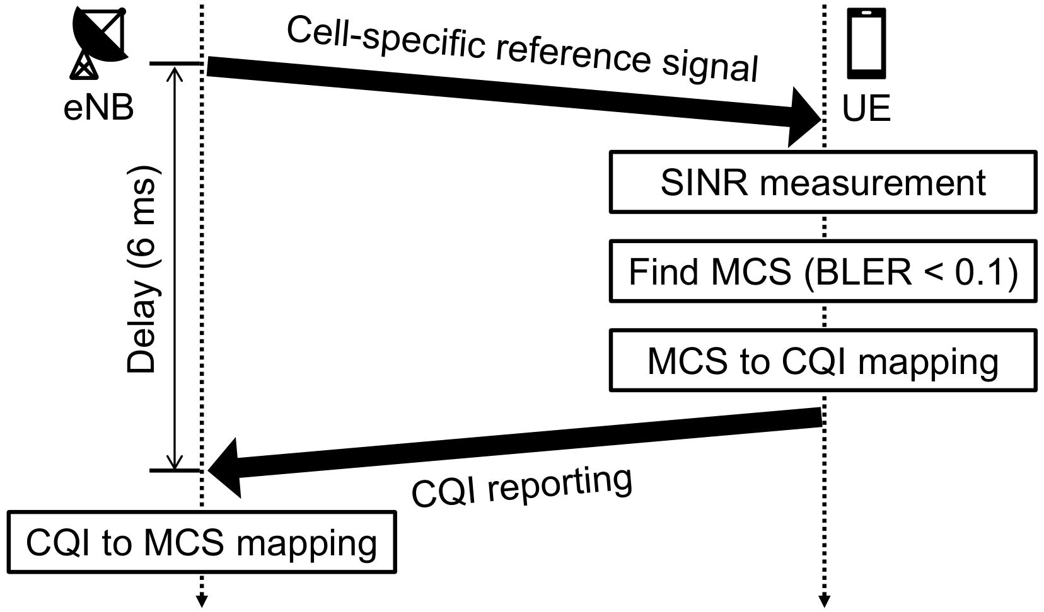
Link Adaptation of LTE (AMC)
Higher modulation & coding scheme (MCS)
Higher throughput
Higher transport block error rate (BLER)
Finding the most suitable MCS is important
LTE link adaptation scheme: Adaptive modulation and coding (AMC)
Notes:
Let me introduce basic link adaptation algorithm of LTE which is used for LAA as well.
Higher MCS can achieve higher throughput.
However, if the signal quality is not good enough, transport block error rate can be very high.
So, we can say that finding the most suitable MCS at given SINR is very important.
AMC does that.
Here is the whole process of AMC.
eNB transmits periodic reference signals and UE measure SINR based on the reference signals.
And UE finds the best MCS which is the highest MCS whose BLER is under 0.1.
Then UE finds corresponding CQI values from MCS/CQI mapping table and report the CQI value.
Then eNB can learn what MCS is the best MCS for downlink transmission to the UE.

Slide 5
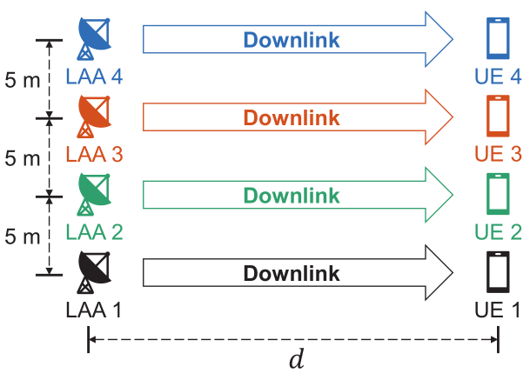
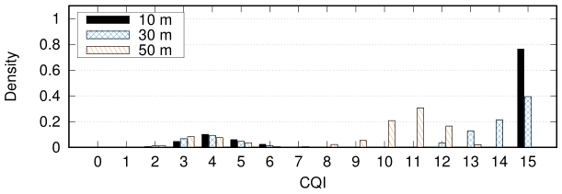
Collision Interference & AMC
What’s new in unlicensed band
There are coexisting LAA of the other operators and Wi-Fi networks
Unexpected/intermittent collision interference
Distribution of CQI reports
Notes:
However, unlike licensed band, there are coexisting networks like LAA of the other operators and Wi-Fi.
And accordingly there can be unexpected/intermittent collision interference.
This graph shows the distribution of CQI reports when 4 LAA eNBs coexists.
You can see that CQI reports are divided into two groups.
This group is composed of the CQI reports which are affected by collision interference.

Slide 6
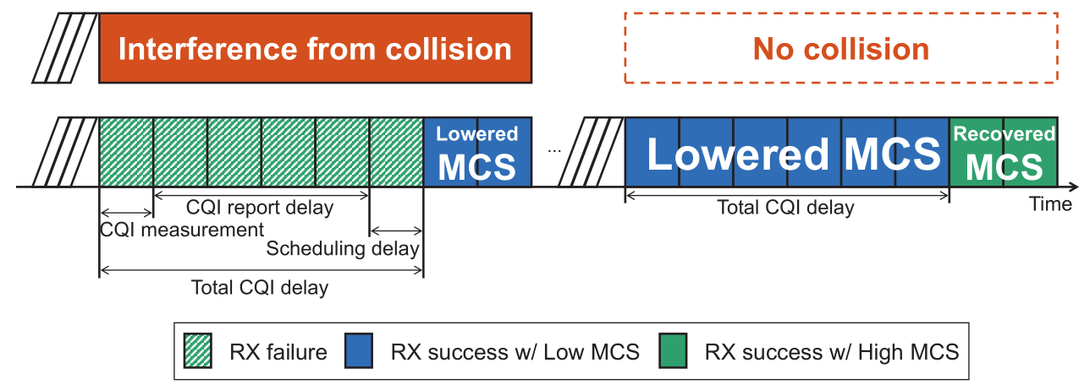
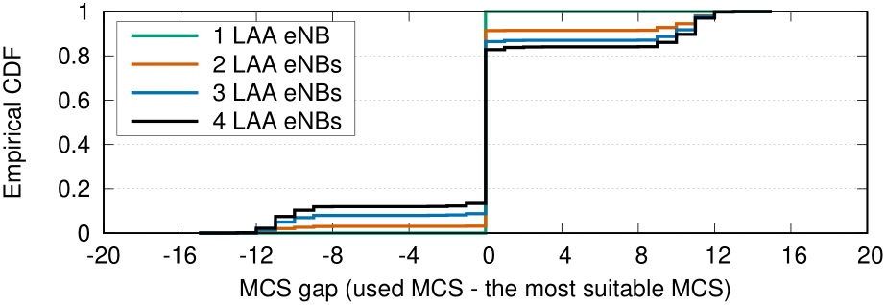
Collision Interference & AMC
Intermittent collision interference deteriorates AMC performance
Late MCS lowering
Due to 6 ms delay
Unnecessary MCS lowering
Successive collision may not happen
Notes:
Will this collision interference can deteriorate AMC performance?
Unfortunately, the answer is YES.
There is a late MCS lowering problem.
If collision happens, only 2 subframes of LAA transmission burst whose maximum duration is 8 ms can be transmitted with lowered MCS.
This is because AMC process takes 6 ms to change MCS.
What makes this problem more complicate is the fact that the next transmission burst will be transmitted with lowered MCS even if there is no collision interference.
Only last 2 subframes will be transmitted with recovered MCS.
The graph on the bottom shows cumulative distribution function of MCS gap values.
MCS gap is defined as the used MCS minus the most suitable MCS.
If the MCS gap is zero, we can learn that the used MCS was the best MCS.
As you can see, non-zero MCS gaps increases as the number of coexisting LAA eNBs increases.

Slide 7
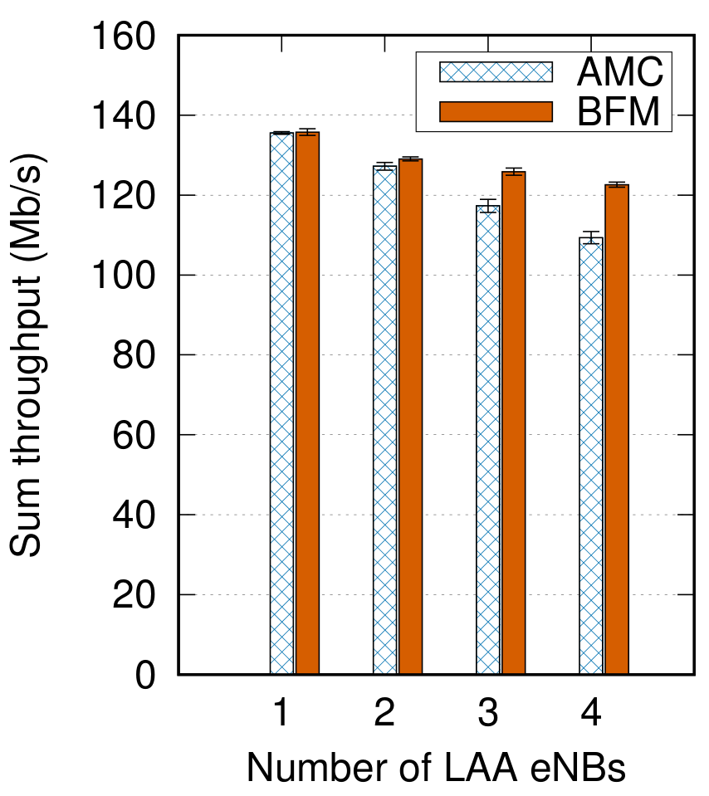
Collision Interference & AMC
Intermittent collision interference deteriorates AMC performance
Late MCS lowering
Due to 6 ms delay
Unnecessary MCS lowering
Successive collision may not happen
More coexisting LAA eNBs → Bigger throughput gap between AMC and BFM
Best fixed MCS (BFM) is found via brute-force search
Notes:
This graph shows the sum throughput performance of AMC and BFM.
BFM means the best fixed MCS.
We found the BFM via brute-force search.
X axis shows the number of LAA eNBs.
You can see that the throughput gap between AMC and BFM increases as the number of LAA eNBs increases.
This is the negative impact of intermittent collision to the AMC operation.

Slide 8
COALA: Collision-Aware Link Adaptation
COALA in a nut shell
By investigating past CQI reports,
Estimate future collision probability
Check whether the most recent CQI report is affected by collision interference
If estimated collision probability is
Zero: Follow AMC operation
Low: Ignore CQI reports which are affected by collision interference
High: Choose MCS which will overcome collision interference
Notes:
Let me introduce our proposed algorithm, COALA, collision aware link adaptation.
COALA investigates past CQI reports to estimate future collision probability and check whether the most recent CQI report is affected by collision interference or not.
And if the estimated collision probability is zero, COALA follows conventional AMC operation.
If the estimated value is non-zero but low, COALA ignores CQI reports which are affected by collision interference.
If the value is high, COALA chooses MCS which will overcome collision interference.

Slide 9
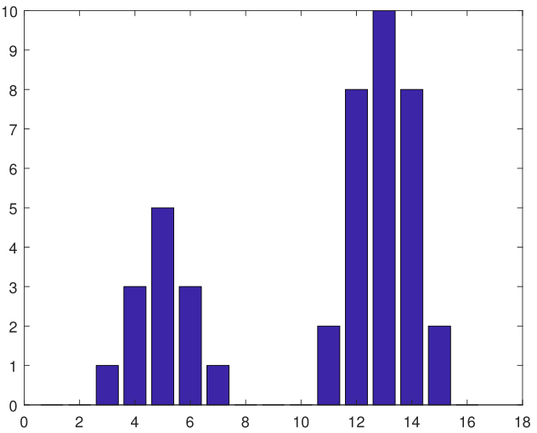
CQI Clustering of COALA
$k$-means clustering algorithm ^{[1]}
One of the simplest unsupervised learning algorithms
Divide data into $k$ clusters
Major problem is to determine the number of clusters ($k$)
$k$-means clustering algorithm in COALA
Leverage Gap statistic method ^{[2]} to find optimal $k$
Optimal $k$ = 1 → No collision
Optimal $k$ > 1 → Collision cluster(s) and non-collision cluster
Non-collision cluster
# reports
CQI
Collision cluster
[1] S. Lloyd, “Least squares quantization in PCM,” IEEE Trans. Inform. Theory, vol. 28, no. 2, pp. 129–137, 1982.
[2] R. Tibshirani, G. Walther, and T. Hastie, “Estimating the number of clusters in a data set via the gap statistic,” J. R. Statist. Soc. B, vol. 63, no. 2, pp. 411–423, 2001.
Notes:
COALA utilizes k-means clustering algorithm to estimate future collision probability.
k-means is one of the simplest unsupervised learning algorithms.
k-means can divide data into k clusters.
However, the major problem is that we have to determine the number of clusters before clustering.
So we leverages gap statistic method to find optimal k.
If the optimal k is 1, we can learn that there was no collision.
If the optimal k is greater than 1, we can learn that there was some collisions and discriminate between collisions clusters and a non-collision cluster.

Slide 10
MCS Selection of COALA
CQI clustering
Receive $CQI_{new}$
$CQI_{new}$: New $CQI$ report
$C_{0}$: Non-collision cluster
$C_{i}$: $i$th collision cluster
$P_{col}$: Collision probability
Non-collision cluster
$$P_{col}>\frac{1}{2}$$
$$CQI_{new}∈\bigcup_{i=1}^{n}{C_{i}}$$
No
No
Yes
Yes
Choose MCS which
has the greatest effective
spectral efficiency
Choose MCS based on the most recent $CQI$ among $C_{0}$
Choose MCS based on $CQI_{new}$
# reports
Collision probability
$$P_{col}=\frac{Number of CQI reports in collision clusters}{Total number of CQI reports}$$
CQI
Collision cluster
Notes:
Here is a flow chart of COALA.
Upon receiving a new CQI value, COALA clusters CQI reports and calculate the collision probability.
The collision probability can be calculated by dividing the number of CQI reports in collision clusters by the total number of CQI reports.

Slide 11
Effective Spectral Efficiency (ESE)
CQI clustering
Receive $CQI_{new}$
$CQI_{new}$: New $CQI$ report
$C_{0}$: Non-collision cluster
$C_{i}$: $i$th collision cluster
$P_{col}$: Collision probability
A
B ($CQI ≥ q$)
$$P_{col}>\frac{1}{2}$$
$$CQI_{new}∈\bigcup_{i=1}^{n}{C_{i}}$$
No
No
Yes
Yes
Choose MCS which
has the greatest effective
spectral efficiency
Choose MCS based on the most recent $CQI$ among $C_{0}$
Choose MCS based on $CQI_{new}$
# reports
ESE of MCS which corresponds to CQI $q$
$$ESE_{q}=SE_{q}∗\frac{B}{A+B}$$
CQI
Notes:
Effective spectral efficiency can be calculated by spectral efficiency times success probability.
Success probability of MCS which corresponds to CQI q is the ratio of CQI reports whose value is over q to total CQI reports.

Slide 12
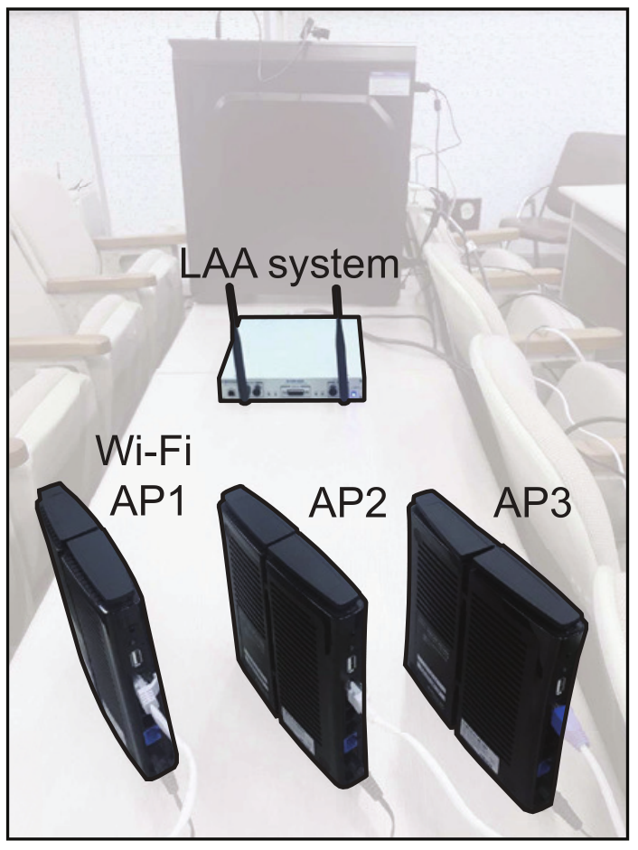
Prototype-based Feasibility Study
Testbed
LAA: NI USRP-2943R
Wi-Fi: Buffalo WZR-HP-AG300H 802.11n AP
20 MHz operating channel (Channel number 44 with 5.22 GHz center frequency)
Notes:
We have implemented the CQI clustering and collision detection algorithm of COALA in LAA testbed for the feasibility study.
We used an NI USRP for LAA testbed and Buffalo commercial off-the-shelf 11n APs for Wi-Fi networks.
Both LAA and Wi-Fi systems utilized 20 MHz operating channel bandwidth.

Slide 13
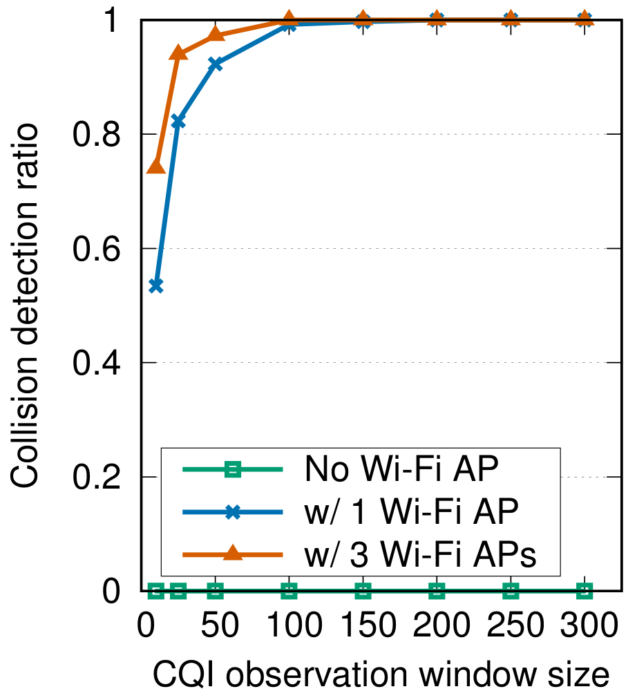
Prototype-based Feasibility Study
Collision detection performance
Collision detection ratio decreases as the CQI observation window size decreases
Collision detection ratio is close to 1 with the CQI window size of 150 or more
Notes:
This figure shows COALA's collision detection performance with varying CQI observation window size.
CQI observation window size is the number of recent CQI reports which COALA uses for collision detection.
The orange line shows the collision detection ratio of COALA when there are 3 coexisting Wi-Fi APs, while the green line shows the detection ratio of COALA with no coexisting Wi-Fi AP.
We can see that collision detection ratio decreases as the CQI observation window size decreases.
And the collision detection ratio is almost 1 with the CQI window size of 150 or more.

Slide 14
Simulation Environment
System level simulator (based on ns-3.22)
Following features have been implemented
Interference between LAA and Wi-Fi
Multiple-input multiple-output (MIMO)
Listen-before-talk (LBT) mechanism
Reservation signal
Partial subframe
3GPP Indoor hotspot channel model
3GPP FTP traffic model
etc.
Simulation parameters
Simulation settings | Value
Simulation time | 10 s
Number of iterations | 10
File size | 0.5 MB
Bandwidth | 20 MHz
Transmission power | 23 dBm
LAA CCA threshold | -72 dBm
Mobile station velocity (for fast fading) | 3 km/h
Notes:
We evaluated the performance of COALA by using ns-3 simulation.
We implemented following features to evaluate 3GPP L A A operation in unlicensed band.
You can find detailed simulation parameters in this table.
Simulation time was 10 s, and the number of iterations was 10, and the used file size was 0.5 MB, and the used bandwidth was 20 MHz, and the transmission power was 23 dBm, and finally L A A CCA threshold was -72 dBm.

Slide 15
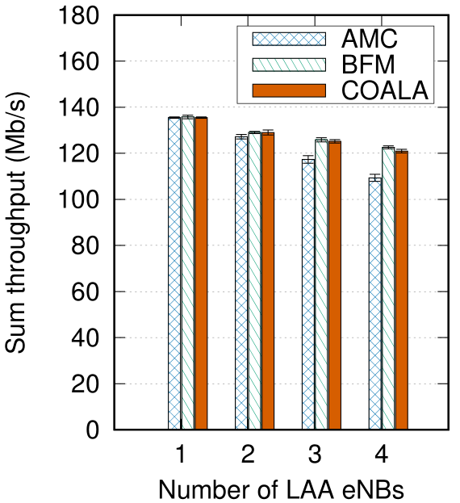
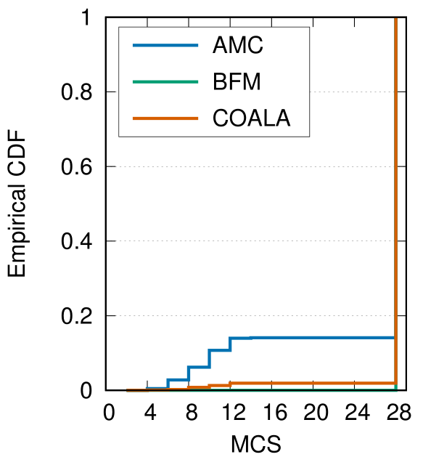
Throughput Performance
Gap btw. AMC & Best Fixed MCS (BFM) increases as the number of LAA eNBs increases
COALA achieves almost the same throughput performance w/ BFM
COALA hardly chooses low MCS
10.6% gain
Notes:
The figure on the left shows the throughput performance of COALA.
X-axis is the number of contending L A A eNBs.
You can see that the gap between AMC and BFM increases as the number of L A A eNBs increases.
However, COALA achieves almost the same throughput performance with BFM.
This is because COALA hardly chooses unnecessarily low MCS.
The throughput performance gain of COALA over AMC was 10.6% when 4 eNBs coexist.

Slide 16
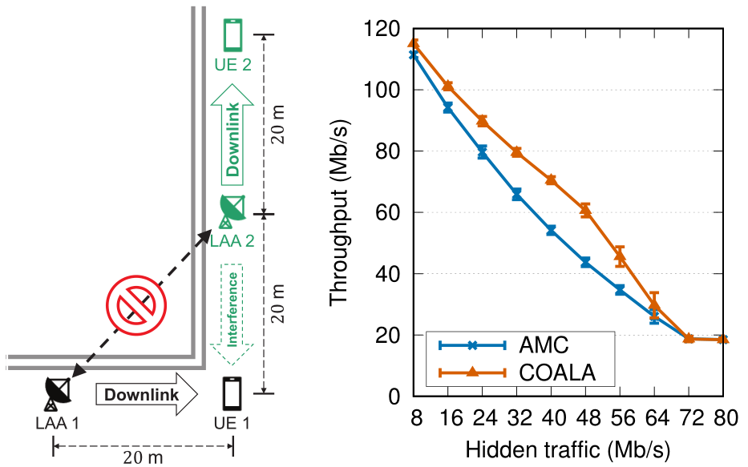
Hidden Collision Scenario
Topology and traffic setting
Fully loaded LAA 1
Generate various source rate of LAA 2
LAA 1 and LAA 2 cannot see each other
When hidden traffic $≥$ 72 Mb/s
Most subframes may suffer from hidden collision
Little chance of incorrect MCS selection
When hidden traffic $<$ 72 Mb/s
COALA achieves higher throughput than AMC
38.6% gain
Notes:
We also evaluated COALA in hidden collision scenario.
Figure on the right hand side shows the throughput performance of LAA eNB 1 with varying hidden traffic source rate of LAA eNB 2.
When the source rate of hidden traffic is greater than or equal to 72 Mb/s, most subframes will suffer from hidden collision and there is little change of incorrect MCS selection.
On the other hand, if the source rate of hidden traffic is less than 72 Mb/s, COALA can mitigate the negative impact of intermittent collision interference and achieve higher throughput than AMC.
The maximum throughput gain of COALA over AMC was 38.6%.

Slide 17
Concluding Remark
COALA
Mitigates harmful effect of collision interference on MCS selection
One of the first work on link adaptation for LAA
3GPP LAA standard compliant
Zero overhead (No additional message exchange)
Future work
Implementation on testbed
Simulation with real traffic trace
Other clustering algorithms (e.g., Gaussian mixture models)

Slide 18
Thank you!
Any Questions?

Slide 19
Modulation & Coding Scheme (MCS)
Quadrature Phase Shift Keying (QPSK)
16 Quadrature Amplitude Modulation (16-QAM)
4 bits per symbol
2 bits per symbol
0011
00
Higher throughput

Slide 20
Modulation & Coding Scheme (MCS)
Quadrature Phase Shift Keying (QPSK)
16 Quadrature Amplitude Modulation (16-QAM)
1010
01
11
Low SINR
1. Path loss
2. Interference
00
10
Higher throughput

Slide 21
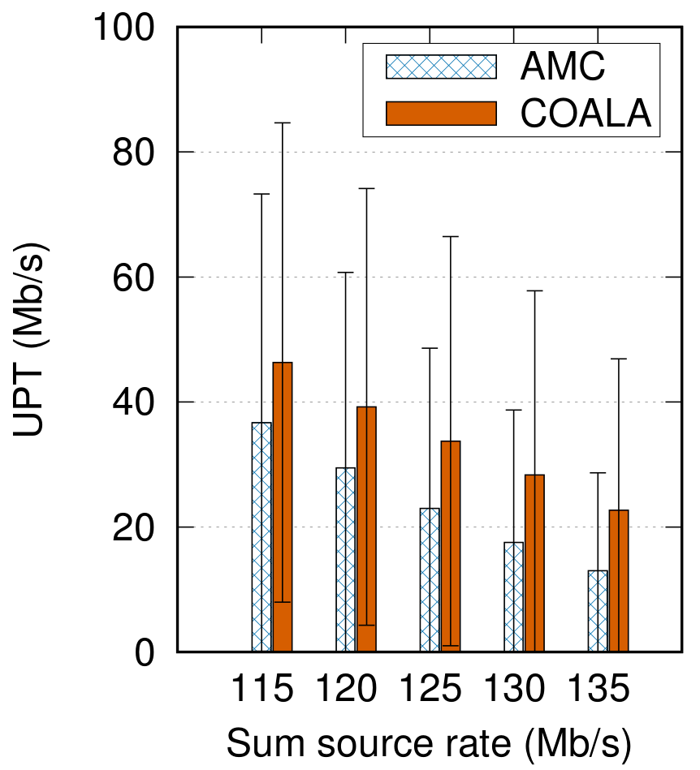
UPT Performance
User perceived throughput (UPT)

Slide 22
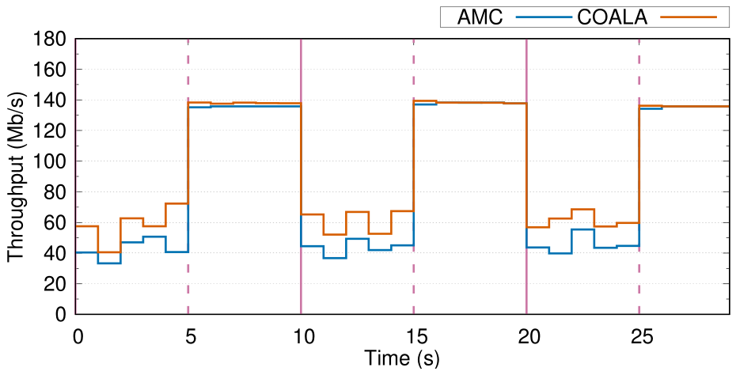
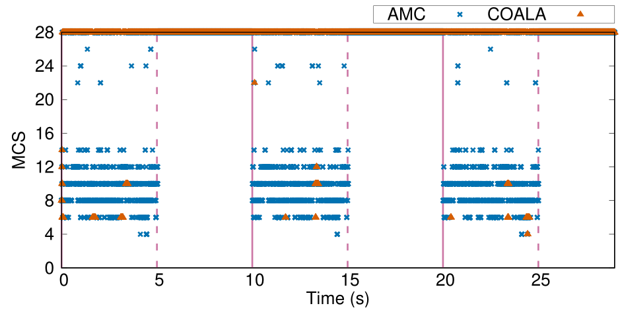
Bursty Hidden Collision Scenario
COALA alleviate throughput degradation
COALA refrains from unnecessary MCS lowering (almost immediately)

Slide 23
Contention Collision in Unlicensed Spectrum
Considerable contention collision probability even with a few TX nodes
Matlab simulation
Binary exponential backoff if collision happens
No hidden terminal
100,000 times channel access

Slide 24
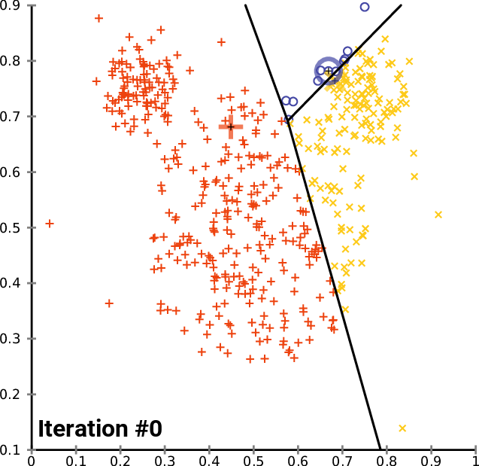
How to Detect Collision with CQI Distribution
k-means clustering [1]
Simplest unsupervised learning (clustering)
Find $k$ cluster centroids of $k$ clusters
Need a priori knowledge about the number of clusters ($k$)
Gap statistic [2]
Fine optimal number of clusters
Compare change in within-cluster dispersion
[1] S. Lloyd, “Least squares quantization in PCM,” IEEE Trans. Inform. Theory, vol. 28, no. 2, pp. 129–137, 1982.
[2] R. Tibshirani, G. Walther, and T. Hastie, “Estimating the number of clusters in a data set via the gap statistic,” J. R. Statist. Soc. B, vol. 63, no. 2, pp. 411–423, 2001.

Slide 25
Gap Statistic [2]
Measure compactness of clusters (for $k=1, 2, …, k_{max}$)
${log⁡(W}_{k})=log⁡(\sum_{r=1}^{k}{\sum_{x_{i}∈C_{r}}{{\left\|x_{i}−μ_{r}\right\|}^{2}}})$, where $k$ = # clusters, $C_{k}$ = $r$th cluster, $x_{i}$ = $i$th data, $μ_{r}$= centroid of $r$th cluster
Find expectation and standard deviation of ${log⁡(W}_{k})$ with $B$ uniform distributions for reference
${E^{∗}\{log⁡(W}_{k})\}=\frac{1}{B}\sum_{b}{\log\left(W_{kb}^{∗}\right)}$, ${sd}_{k}={\left[\frac{1}{B}\sum_{b}{{\left\{\log\left(W_{kb}^{∗}\right)−{E^{∗}\{log⁡(W}_{k})\} \right\}}^{2}}\right]}^{1/2}$
$Gap(k)=\frac{1}{B}\sum_{b}{\log\left(W_{kb}^{∗}\right)}−{log⁡(W}_{k})$
Optimal $k$ = smallest $k$ such that $Gap\left(k\right)≥Gap\left(k+1\right)−{sd}_{k+1}\sqrt{1+1/B}$
[2] R. Tibshirani, G. Walther, and T. Hastie, “Estimating the number of clusters in a data set via the gap statistic,” J. R. Statist. Soc. B, vol. 63, no. 2, pp. 411-423, 2001.

Slide 26
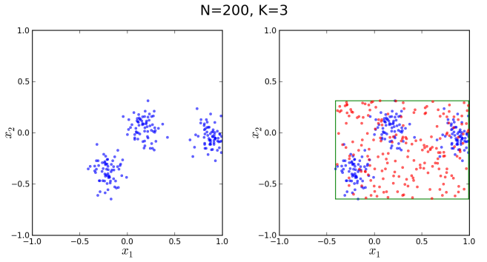
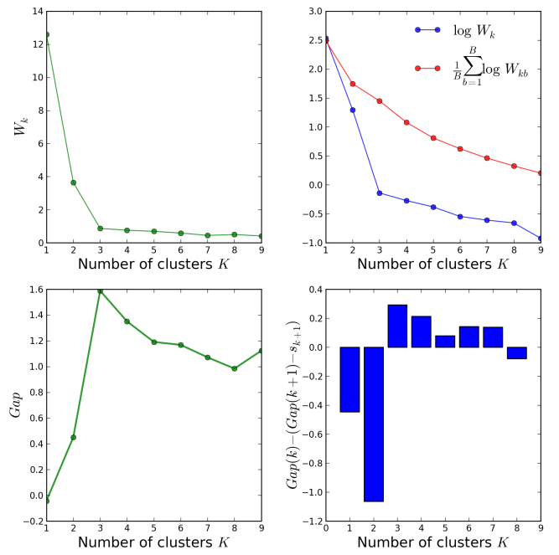
Gap Statistic [2]
Figures from https://datasciencelab.wordpress.com/2013/12/27/finding-the-k-in-k-means-clustering/
[2] R. Tibshirani, G. Walther, and T. Hastie, “Estimating the number of clusters in a data set via the gap statistic,” J. R. Statist. Soc. B, vol. 63, no. 2, pp. 411-423, 2001.

Slide 27
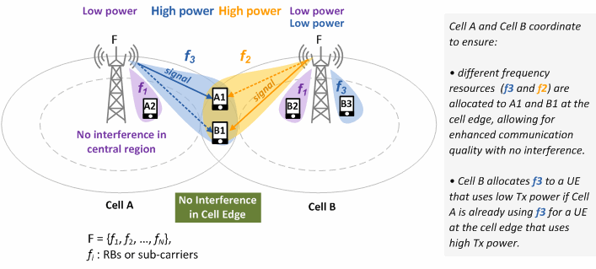
Inter-Cell Interference Coordination (ICIC)
Defined in 3GPP release 8
Allows cell-edge UEs in neighbor cells to use different frequency ranges (RBs or sub-carriers)
[1] http://www.netmanias.com/en/?m=view&id=blog&no=6391

Slide 28
Enhanced Inter-Cell Interference Coordination (eICIC)
Defined in 3GPP release 10 to support HetNet environments
Allows cell-edge UEs in neighbor cells to use different time ranges (subframes)
Almost Blank Subframe (ABS)
ABS pattern is delivered over X2 interface
[1] http://www.netmanias.com/en/post/blog/6551/lte-lte-a-eicic/interference-coordination-in-lte-lte-a-2-eicic-enhanced-icic

Slide 29
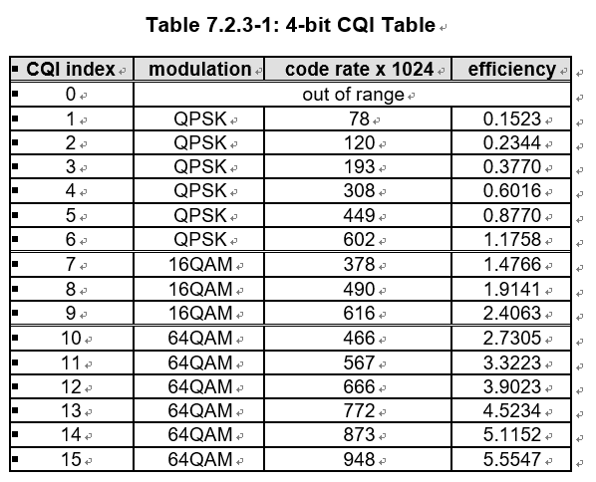
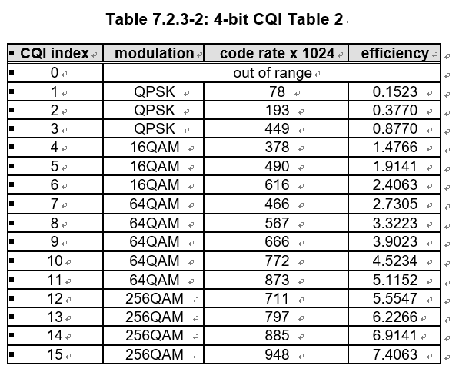
Channel Quality Indicator (CQI) Feedback [1]
Highest CQI index (between 1 and 15)
Satisfy following condition: Transport block error probability not exceeding 0.1
[1] 3GPP TS 36.213 v13.5.0, Evolved universal terrestrial radio access (EUTRA) physical layer procedures (Release 13), Mar. 2017.

Slide 30
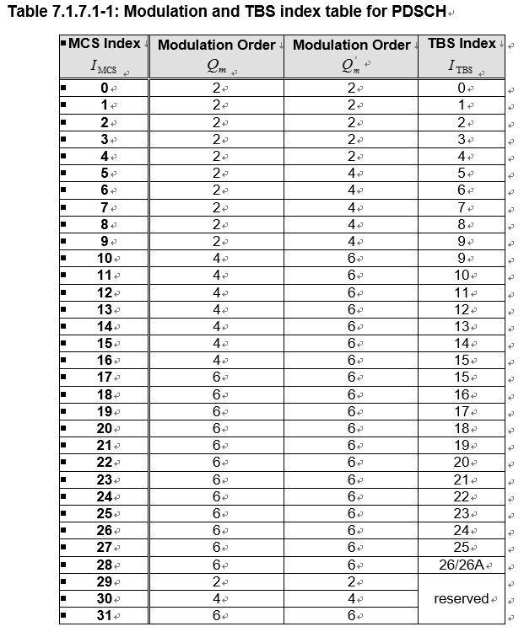
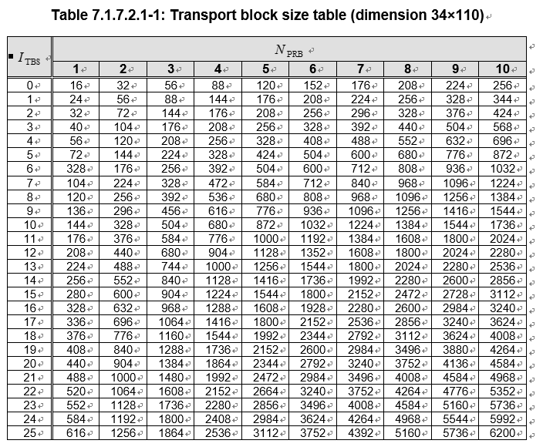
MCS Table [1]
Code rate = (TBS+CRC)/(RE*modulation_order)
CRC = 24
Resource element (RE) = $N_{PRB}$ * #subcarriers (12) * #OFDM_symbols (7) * #slots_per_subframe (2) * (1 - control_channel_overhead) ^{[2]}
[1] 3GPP TS 36.213 v13.5.0, Evolved universal terrestrial radio access (EUTRA) physical layer procedures (Release 13), Mar. 2017.
[2] (1 - control_channel_overhead) = 0.711905 (FDD Donwlink)

Slide 31
MCS Table [2, 3]
[2] Qualcomm Europe, “Conveying MCS and TB size via PDCCH,” 3GPP TSG-RAN WG1 #52bis R1-081 483, Apr. 2008.
[3] Gwanmo Ku and John MacLaren Walsh, “Resource Allocation and Link Adaptation in LTE and LTE Advanced: A Tutorial,” IEEE Commun. Surveys Tuts., vol. 17, no. 3, 2015.

Slide 32
Channel Quality Indicator (CQI) Feedback [1]
Periodic CQI reporting (via PUCCH)
TX every 2, 5, 10, 20, 32, 40, 64, 80, 128, and 160 subframes
Wideband: Median of CQIs in the whole system bandwidth
UE selected sub-band:
Sub-bands are further partitioned into “bandwidth parts”
UE selects bandwidth parts to report CQI
Aperiodic CQI reporting (via PUSCH)
Wideband: (Same with periodic CQI reporting)
Higher layer configured sub-band: Wideband CQI + differential CQIs of each sub-bands
UE selected sub-band: Wideband CQI + differential CQI for the preferred sub-bands
[1] Gwanmo Ku and John MacLaren Walsh, “Resource Allocation and Link Adaptation in LTE and LTE Advanced: A Tutorial,” IEEE Commun. Surveys Tuts., vol. 17, no. 3, 2015.

Slide 33
Channel Quality Indicator (CQI) Feedback
UE procedure for calculating the CQI
UE reports a transport format (modulation and code rate) if 10 % BLER can be achieved after the first transmission when the Node B schedules with the reported transport format over a set of PRBs, for which the CQI report applies [1, 2]
[1] 3GPP, “Summary of AH Session on AI 6.4.5 UE Procedures for Downlink Shared Channel,” 3GPP Technical Specification Group Meeting Document R1-075 069, Nov. 2007.
[2] 3GPP, “Draft Report of 3GPP TSG RAN WG1 #51 v1.0.0,” 3GPP Technical Specification Group Meeting Document R1-080 002, Jan. 2008.
[3] 3GPP, “LS on CQI Definition,” 3GPP Technical Specification Group Meeting Document R1-082 632, Jun. 2008.

Slide 34
Channel Quality Indicator (CQI) Feedback
UE shall report the highest tabulated CQI index for which a single PDSCH sub-frame with a transport format (modulation and coding rate) and number of REs corresponding to the reported (or lower) CQI index could be received with individual transport block error probability not exceeding 0.1 in a downlink subframe [3]
[1] 3GPP, “Summary of AH Session on AI 6.4.5 UE Procedures for Downlink Shared Channel,” 3GPP Technical Specification Group Meeting Document R1-075 069, Nov. 2007.
[2] 3GPP, “Draft Report of 3GPP TSG RAN WG1 #51 v1.0.0,” 3GPP Technical Specification Group Meeting Document R1-080 002, Jan. 2008.
[3] 3GPP, “LS on CQI Definition,” 3GPP Technical Specification Group Meeting Document R1-082 632, Jun. 2008.

Slide 35
Thank you

