Slide 1
AHT: Application-Based Handover Triggering for Saving Energy in Cellular Networks
Di Zhang, Yuezhi Zhou, Xiang Lan,
Yaoxue Zhang, Xiaoming Fu
2018-06-12

Slide 2
Table of Contents
Motivation
Measurement Studies
AHT: Application-Based Handover Triggering
Application Classification
Upward Handover
Downward Handover
Evaluation Results
Conclusions and Future Works

Slide 3
Motivation
Mobile devices are ubiquitous and indispensable
Mobile subscriptions are large and increase fast
Mobile applications are increasingly popular
Source: ITU World Telecommunication / ICT Indicators database
Note: *Estimate
Source: http://www.pocketgamer.biz

Slide 4
Motivation
Battery is a bottleneck of mobile devices
Cellular data communication is a significant source
Source: http://www.gsmarena.com/battery-test.php3

Slide 5
Motivation
Various heterogeneous cellular networks
GSM, UMTS, LTE, etc.
Miscellaneous applications need data access
Instant messaging, social networking
There is a barrier between heterogeneous cellular networks and applications

Slide 6
Measurement Studies
To understand the barrier between heterogeneous cellular networks and applications
Measurement configurations
Cellular networks
EDGE, UMTS, and LTE
Mobile device
HTC M8 (equipped with a battery fuel gauge)
Tool
EnergyTool (http://github.com/dizhang/EnergyTool)
Get voltage and current from /sys/class/power_supply

Slide 7
Measurement Studies
Energy consumption with different cellular networks
An energy state machine exists in each data transmission
EDGE
UMTS
LTE
EDGE: limited bandwidth → long transmission time
UMTS: long promotion time → high latency
LTE: long tail time → much energy consumed in tail time

Slide 8
Measurement Studies
Energy consumption with different data size
EDGE is difficult to meet the requirements of modern applications.
UMTS is more energy efficient than LTE.

Slide 9
Measurement Studies
Impact of the cellular network type on applications
Application | Network Type | Time (ms) | Energy (mJ)
Email checking | EDGE | 5626.4 | 4823.6
 | UMTS | 2506.3 | 4537.0
 | LTE | 436.8 | 11474.3
Web page loading | EDGE | 117067.6 | 163917.9
 | UMTS | 5879.4 | 35614.6
 | LTE | 3511.4 | 44425.3
There is no direct interaction between heterogeneous cellular networks and various applications, which leads to the high energy consumption of cellular data transmissions.
The cellular network type exerts a crucial influence on energy consumption and performance of applications.

Slide 10
AHT: Overall Idea
Divide heterogeneous cellular networks
high performance networks with high bandwidth
energy-efficient networks with low energy consumption
Classify various applications
UX-sensitive ones that affect the user experience
UX-insensitive ones that do not affect the user experience
An ideal situation
UX-sensitive data → high-performance network
UX-insensitive data → energy-efficient network
AHT triggers handovers based on applications

Slide 11
Challenges
How to determine whether an application is UX-sensitive or UX-insensitive?
Various users
Configurable
How to trigger handovers to the high-performance network?
Reduce the impact of handover delay
How to trigger handovers to the energy-efficient network?
Reduce the number of back-and-forth handovers

Slide 12
Application Classification
AHT classifies applications through user preferences
To meet the requirements of various users
Configurable
Appropriate default values are set to reduce the complexity of using AHT
Common UX-sensitive applications are set in default
A whitelist is used to determine UX-sensitive applications
Applications that are not in the list are regarded as UX-insensitive

Slide 13
Upward Handover
Upward handover refers to the handover to the high-performance network
Application prediction based handover triggering
AHT triggers the upward handover before a UX-sensitive application is used based on application prediction
Two problems
How to predict the next application?
When to trigger upward handover?

Slide 14
Upward Handover Decision
Requirements of applications prediction
Low training overhead
Adapt to various users and rapidly changing user habits
Prediction by partial match (PPM)
Use the prefix character sequence to calculate the conditional probability of the next character
Handover decision
R={a₁, …, a_{n}} is the UX-sensitive application set, P_{next}={a₁, …, a_{m}} is a set of applications that may be used as the next
∃ a_{i} ∈ R, a_{i} ∈ P_{next}, and the network is not the high-performance network, AHT prepares to trigger a handover

Slide 15
Upward Handover Time
…
…
…
…
ui₁
ui₂
ui_{i}
ui_{j}
ui_{n}
Time
h₁
h₂
h_{i}
h_{j}
h_{n}
PPM
Historical UI probability
CDF
UI
To ensure that all historical handovers
for a will be conducted before a is used
The conditional cumulative distribution function of a that a will be used within Δt period

Slide 16
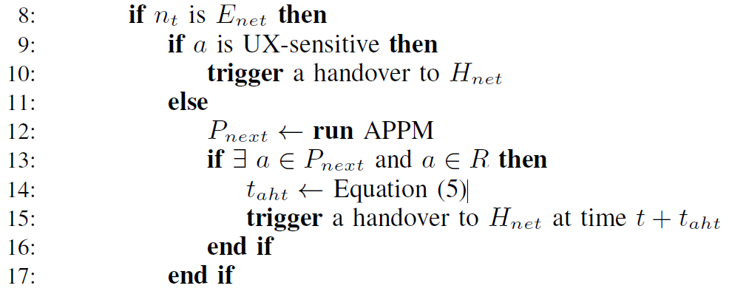
Upward Handover
The upward handover algorithm

Slide 17
Downward Handover
Downward handover refers to the handover to the energy-efficient network
Immediate handover at the end use of a UX-sensitive application
Interruption of in-progress data transmission
Incur back-and-forth handovers
AHT employs an idle timer to trigger handovers to the energy-efficient network
Similar to the inactivity time in radio resource control protocol

Slide 18
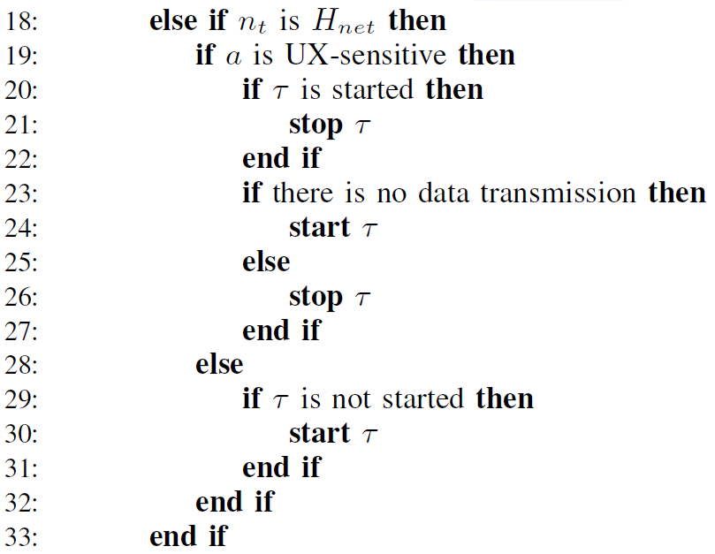
Downward Handover
The downward handover algorithm

Slide 19
Performance Evaluation
Data sets and configurations
Application usage data from the LiveLab in Rice University
Parameters are obtained through measurement studies
Performance metrics
Energy consumption
Number of total handovers
Proportion of data transmissions with high latency
Comparison
Pure network: UMTS and LTE
Auto: signal strength based handover
Intelli3G: screen status based handover

Slide 20
Evaluation Results
Energy consumptions of data transmission for different users
Compared with the pure LTE network, AHT saves up to 60.7% and at least 36.9% energy consumption
Compared with Intelli3G, AHT saves up to 32.8% and at least 12% energy consumption

Slide 21
Evaluation Results
Number of total handovers
Compared with Auto and Intelli3G, AHT reduces the number of handover by an average of 62.3% and 42.4%, respectively

Slide 22
Evaluation Results
Proportion of data transmissions with delay more than 2 seconds
The proportion of UMTS is the highest
Compared with Intelli3G, AHT increases the proportion by an average of 8.4% due to application prediction errors

Slide 23
Conclusions and Future Works
AHT: Application-Based Handover Triggering
Clarify the barrier between heterogeneous cellular networks and applications
Propose an application-based handover triggering method
Based on practical application usage traces, we evaluate the performance of AHT and show its better performance
Future Works
Integrating AHT with existing handover protocols
Dynamic idle timer

Slide 24
Thank you!
Q & A

