Slide 1


Missing-Tag Detection With Presence of
Unknown Tags
Youlin Zhang, Shigang Chen, You Zhou, Olufemi Odegbile
Computer & Information Science & Engineering Department, University of Florida
June 13rd, 2018
Notes:
The title of this work is
Missing-Tag Detection With Presence of
Unknown Tags

Slide 2
Outline
Background
Motivation
Protocol Design
Evaluation
Notes:
This is the outline of my presentation
First, I will give some background information about RFID technology and missing tag detection.
Then, I will introduce the motivations for this paper.
After that I will describe in details the protocol design.
Finally I will give some evaluation results.
If you have any questions, please feel free to interrupt.

Slide 3
Outline
Background
Motivation
Protocol Design
Evaluation
Notes:
I will first start with some background introduction.

Slide 4

Internet of Things and RFID technology
Notes:
Recent years have seen the development of Internet of things, with the application of RFID technology.
In the future, each object may be attached with an RFID tag, which has a unique tag ID for identification

Slide 5
Internet of Things and RFID technology
Object Tracking
Access
Control
logistics
management
…
RFID
Identification
Automation
Notes:
RFID has been widely used in many applications such as object tracking, access ctrl, warehouse management, and so on..

Slide 6
Slot-based ALOHA Protocol
tag 1
tag 2
An
ALOHA
Frame
…
tag n
…
Notes:
In practice, an rfid system has three components: RFID reader, antennas and a set of RFID tags. A reader can be connected with one or multiple antennas, through which it can query tags. One communication round is started by a reader broadcasting an aloha frame, which includes some parameters like frame size and random seeds.
The tags will pick a slot in the frame based on these parameters and send back a response.

Slide 7

Slot-based ALOHA Protocol
Snapshot of a tag set:
  An ALOHA frame can be converted to a bitmap by mapping each picked slot as 1 and each unpicked slot as 0
tag 1
tag 2
…
tag n
…
0
1
0
0
1
0
…
0
0
0
7
Notes:
In many real applications, the aloha frame will be converted into a bitmap by mapping each picked slot as 1 and unpicked slot as zero, which can be taken as a snapshot of the tag set.
This snapshot contains the information of these tags, which be computed if the tag ID information is known and thus can be used to identify the existence of tags.

Slide 8
Slot-based ALOHA Protocol
Snapshot of a tag set:
  An ALOHA frame can be converted to a bitmap by mapping each picked slot as 1 and each unpicked slot as 0
tag 1
…
tag n
…
0
0
0
0
1
0
…
0
0
0
8
Notes:
In this example, if tag 2 is missing, the second bit in our collected snapshot will become 0. By comparing it with the previous one, we can know that tag 2 is missing since it is the only tag that is supposed to be mapped into that slot.
However, if tag 1 or tag n is missing, the corresponding slot will still be picked and that bit is still 1.
Therefore, the key is to reduce the collision in each slot such that the performance is enhanced.

Slide 9
Outline
Background
Motivation
Protocol Design
Evaluation
Notes:
Now I will try to motivate our paper by giving some examples.

Slide 10
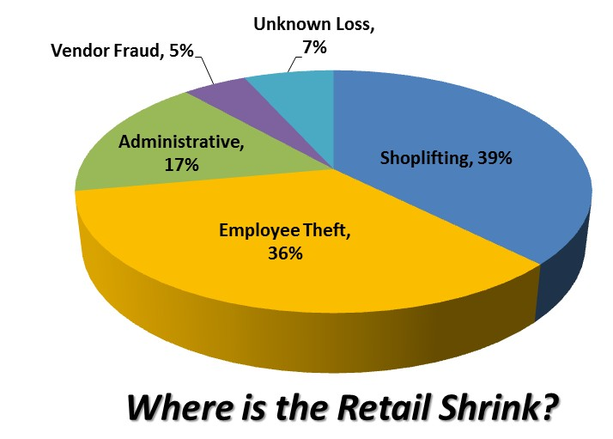
Motivation
Notes:
According to some news, employee theft and shoplifting are the major causes of capital loss.

Slide 11

Missing Tag Detection
We abstract the products (attached with RFID tags) in a warehouse as a set of tags.
tag
…
Notes:
If we attached tags to all products, we can abstract the products in the warehouse as a set of tags.
The problem can be solved by taking a snapshot of the given tag set and detecting missing tags.

Slide 12

Missing Tag Detection
C. Tan et al. (INFOCOM 2008)
W. Luo et al.(Mobihoc 2012)
tag
…
Notes:
As aforementioned, if some of the tags are missing, an expected mapped slot will become empty, which implies that the tag is missing.
Existing works use this approach to solve this problem and assume the full knowledge of the tag set.

Slide 13

Missing Tag Detection With Unknown tags
Unknown tags can introduce false positives.
unknown tag
known tag
…
Notes:
However, in practice, the application scenario is more open, where unknown tags can exist.
These unknown tags respond to the reader in the same manner as known tags and will introduce false positives into previous approaches.

Slide 14

Our Goal and Challenge
Goal: Efficient and accurate missing tag detection with the presence of unknown tags
Challenges
  Efficiency
  Accuracy: detection probability $α$
Notes:
Therefore, in this paper our goal is to efficiently and accurately detect missing tags with the presence of unknown tags.
The first challenge is the efficiency of our protocol. We want to minimize the execution time of our protocol.
Second, we also want to detect the missing-tag event accurately with a detection probability of alpha.

Slide 15
Outline
Background
Motivation
Protocol Design
Simulation results
Notes:
Now I will introduce the design of the protocol.

Slide 16
Our Approach:
Basic idea
  Broadcast a Compressed filter to filter out unknown tags
  Combine sampling and multi-seed mapping for snapshot collection
  Compare the collected snapshot with the precomputed snapshot to identify missing tags
Notes:
The basic idea is to first use compressed filter to filter out unknown tags. The compressed filter is build upon a Bloom filter by some compression.
After that, we use techniques of sampling and multi-seed mapping to collect the snapshot of the left tag set.
Finally, we compare our collected snapshot with the computed one to identify missing tags.

Slide 17
Design of Compressed Filter
Take an original Bloom filter
Compress consecutive zeros and leave out ones
Notes:
First we introduce the design of compressed filter.
It takes a Bloom filter, which can be computed with all known tag IDs and compress the continuous zeros in it.
This compressed filter is then broadcast by the reader to filter out unknown tags, making them inactive for missing tag detection.
The figure below shows an example of how to compress a Bloom filter.
As we can see, the continuous zero bits are compressed using binary encoding and all bit ones are not included in the compressed filter.
As a result, the size of the filter reduces, which saves a lot of time for broadcasting the filter.

Slide 18
Missing tag detection
Sample tags to reduce population size.
For sampled tags, we use multi-hashing to reduce collisions.
Snapshot comparison.
Notes:
In the phase of missing tag detection, we first using a sampling technique to reduce the number of tags that will participate in the communication.
Then for the tags that are sampled, we use multi-hashing to reduce collisions.
The figure below illustrates multi-hashing. We use the first four bits to decide which sub-frame we will encode and use the following bits to encode in the subframe.
After collecting the snapshot of the tag set, we compare it with the computed snapshot and get our detection result.
Due to time constrains, I just give the basic idea of the operation. More details can be found in the paper.

Slide 19
Outline
Background
Motivation
Protocol Design
Evaluation
Notes:
Now I will give some evaluation results.

Slide 20

Simulations
A large RFID system:
  Known tags n: 5000 ~ 10000;
  Missing tags m: 50 ~ 100;
  Unknown tags |U|: 50000 ~ 100000
Performance Metric
  Reliability: $α$
  Execution time
Notes:
We evaluate the performance of our protocol by simulations.
We simulated a large distributed RFID system, where the number n of known tags ranges from 5000 to 10000, the number m of missing tags ranges from 50 to 100 and the number U of unknown tags ranges from 50,000 to 100,000.
The performance metrics are reliability and execution time. We want to verify that our protocol can detect an missing tag event with the required probability and we take less time than the state-of-the-art.

Slide 21
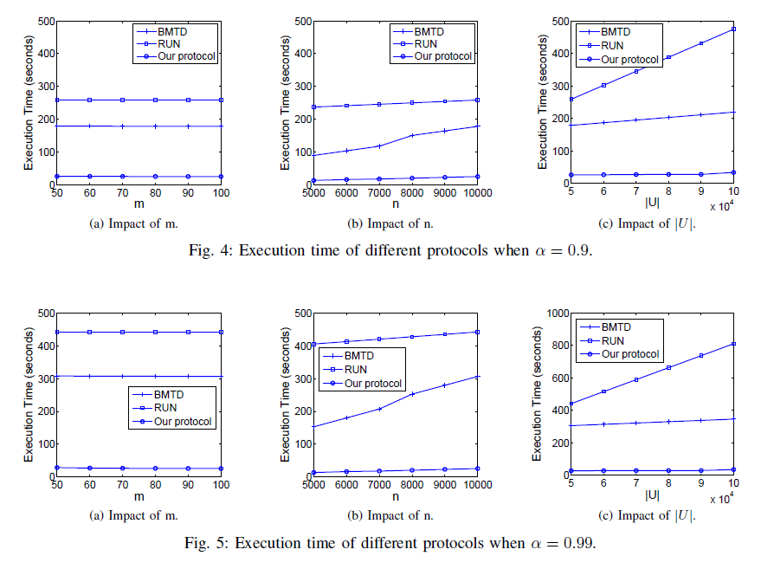
Simulation Results
Notes:
These figures show the execution time of our protocol compared with BMTD and RUN.
Each point in the figure is an instance of our simulation, where x-axis is different parameters including m, n, and |U| and y-axis is the execution time in seconds.
In general, our approach reduces the execution time by 80 to 90 percent. Moreover, the execution time of our protocol remains stable, while the other two approaches increase.
In conclusion, our protocol outperforms the state-of-the-art.

Slide 22
Thanks!
Notes:
That is all for my presentation.
Thanks

