Slide 1

BLEND: BLE Beacon-Aided Fast WiFi Handoff for Smartphones
Junyoung Choi, Gyujin Lee, Yeonchul Shin, Jonghoe Koo, Minseok Jang, and Sunghyun Choi
Multimedia & Wireless Networking Laboratory
Seoul National University, Korea
June 13, 2018
Notes:
Let me start my presentation. Hello, everyone. I’m Junyoung Choi from Seoul National University and my advisor is Sunghyun Choi. Today, I’ll present our work. The title is BLE Beacon-Aided Fast WiFi Handoff for Smartphone.

Slide 2




Introduction
Extreme proliferation of smartphones
Usage of WiFi while on the move
Handoff between access point (AP) is important
Notes:
The extreme proliferation of smartphones has made WiFi an indispensable wireless technology in our daily lives. WiFi is still expected to serve as a hub for immense mobile application and data traffic in the future. The top-ranked applications are YouTube, Facebook, and Twitter. Also, smartphone users frequently use these applications on the move. So, when users roam while using these mobile applications, handoff between WiFi access point (AP) should be conducted in a timely manner in order to provide continuous WiFi service.

Slide 3



Problem
Maintain WiFi connection with very low signal strength
Sticky client problem ^{[1]}
  Annoying problem causing deactivation of WiFi
AP 1
Lower signal strength
Higher
signal strength
Still associated with AP 1
AP 2
Example of the sticky client problem
[1] J. Shi, L. Meng, A. Striegel, C. Qiao, D. Koutsonikolas, and G. Challen, “A Walk on the Client Side: Monitoring Enterprise WiFi Networks Using Smartphone Channel Scans,” in Proc. IEEE INFOCOM, 2016.
Notes:
However, we frequently experience that smartphone maintains WiFi connection with very low signal strength even though nearby APs can provide much higher signal strength. This means smartphone does not perform handoff properly. Such undesirable behavior of smartphone is known as sticky client problem. This is considered one of the most annoying problems that causes smartphone users to simply deactivate WiFi. To overcome the sticky client problem, smartphone needs to perform fast handoff on time to nearby APs which can provide better service or throughput.

Slide 4
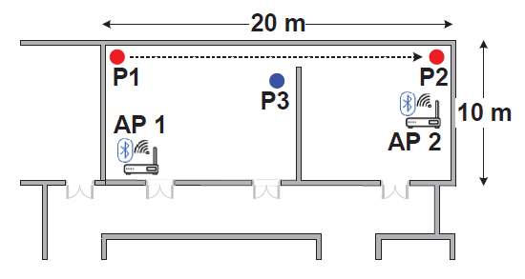
Preliminary Experiment
Observe the sticky client problem on commercial smartphone
Experiment setup
  Moving direction: P1 → P2
  1 m/s walking speed
  Scenarios
    S1: initially associated with AP 1
    S2: initially associated with AP 2
  Saturated UDP traffic
Received signal strength indicator (RSSI) and throughput
Notes:
First, we conduct experiment to confirm that the sticky client problem really occurs on commercial smartphones. We conduct an experiment in the controlled indoor office environment illustrated as this figure. AP1 and AP2 operate on different channels. We use Google Nexus 5 with Android version 6 Marshmallow for the experiment. The smartphone is initially located at P1 for 20s, moves from P1 to P2 with an average walking of 1 m/s, and then stays at P2 for the last 20s. We conduct the experiment in two scenarios. In scenario 1 and scenario 2, smartphone is initially associated with AP1 and AP2, respectively. Both APs generate saturated UDP traffic only when smartphone is associated. We measure received signal strength indicator (RSSI) and throughput at smartphone during 60s.

Slide 5
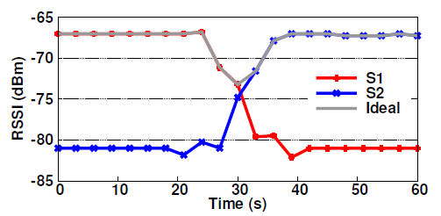
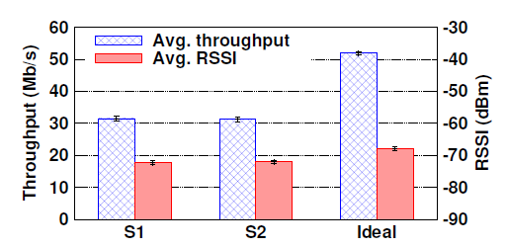
Preliminary Experiment
Received signal strength indicator (RSSI) and throughput
Observe the sticky client problem
Up to 66% throughput improvement
  When perform handoff ideally
Need proper handoff mechanism for smartphone
RSSI in time domain
Average throughput and RSSI
Notes:
This left figure represents RSSI in time domain. The red line is S1 and the blue line is S2. In S1, RSSI decreases as smartphone moves away from AP1. When smartphone reaches at P2, we expect that it performs handoff to AP2. However, smartphone does not perform handoff to AP2 even though RSSI of AP1 is under -80dBm. Similarly, smartphone does not perform handoff to AP1 during first 20s in S2. So, we observe that smartphone does not perform handoff even if RSSI of the associated AP is extremely low even though there exists another AP which can support higher RSSI or throughput. If smartphone perform handoff like ideal which follows upper most curve of S1 and S2, throughput can be enhanced up to 66%. Therefore, appropriate handoff operation for smartphone is absolutely necessary.

Slide 6
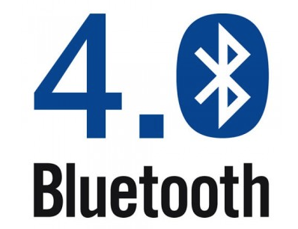
Design Philosophy
Practicality as a top priority
  Practical and simple solution
  Directly applicable to smartphone
  Without any hardware and firmware modification
BLEND: proposed scheme
  Utilize Bluetooth Low Energy (BLE)
  AP collocated with BLE beacon device
  Provide side information through BLE
Notes:
Motivated by the fact that handoff dedicated to smartphone should be supported, we set our goal as designing a practical and simple handoff scheme, which is directly applicable to smartphone without any hardware and firmware modification. We propose fast handoff scheme called BLEND using Bluetooth Low Energy as secondary radio. AP is collocated with BLE and periodically transmits BLE advertising packet. So, AP provides side information to smartphone through BLE. This is the main concept of BLEND.

Slide 7
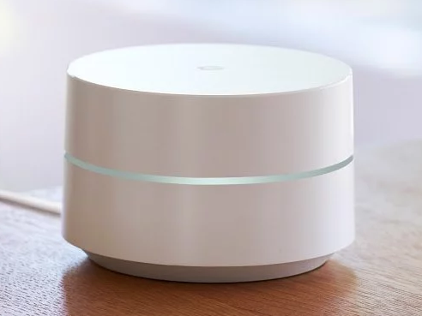
Why BLE?
Already equipped with AP and smartphones
  Google WiFi and Samsung Connect Home
  Android version 4.3 Jelly bean (2013) and later of smartphone
  No hardware modification
Advantage of BLE
  Guarantee the existence of AP in vicinity
    Prior knowledge of AP without WiFi scanning
  BLE Android API
    Direct root to deliver information of BLE packet to application layer
  No BLE connections
Notes:
Someone may have a question. Why BLE? First, today’s AP such as Google WiFi and Samsung Connect Home are embedded with BLE. Second, most commercial smartphones are equipped with BLE module. Therefore, no hardware modification is required. Also, utilizing BLE has some advantages. Considering that BLE is short-range wireless technology compared with WiFi, receiving advertising packet guarantee that there is AP in vicinity without WiFi scanning. So, smartphone can have prior knowledge of AP in advance. In addition, there is BLE Android API. BLE advertising packet information can be directly delivered to application layer thanks to this API. Therefore, any firmware modification is unncessary. Also, BLEND makes no BLE connections, it can operate without interfering other BLE connections such as wearable device.

Slide 8



BLEND: Proposed Scheme
AP operation
  Transmit BLE advertising packet periodically
  BLE advertising packet containing AP’s information
Smartphone operation
  Turned on BLE module
  Receive BLE advertising packet from AP
  Estimate throughput based on information and determine handoff
Handoff decision
BLE advertising packet
Notes:
We proposed simple and practical solution for handoff. AP periodically transmits BLE advertising packet containing information about AP. And smartphone turns on BLE module to receive BLE advertising packet. If smartphone receives advertising packet from AP, it estimates the throughput of AP based on the information contained in advertising packet. After that smartphone determine whether perform handoff or not.

Slide 9
BLEND: Proposed Scheme
AP operation
Calculate the available channel occupancy ratio (ACOR)
  Opposite concept of channel utilization
  Exponentially weighted moving average
    Avoid fluctuation due to burst traffic
Periodically transmit BLE advertising packet
  Containing operating channel, MAC address, and ACOR
Advertising packet payload
Channel
MAC address
ACOR
Notes:
The operation of AP is very simple. AP calculates available channel occupancy ratio, called ACOR, which is represent opposite concept of channel utilization. That means ACOR represent the ratio of time that channel is idle. To avoid fluctuation of ACOR due to burst traffic like video, we take exponentially weighted moving average on AOCR. Then, AP periodically transmits BLE advertising packet containing it’s information such as operating channel, MAC address, and ACOR. That’s it.

Slide 10
BLEND: Proposed Scheme
Smartphone operation
BLE receiver
  Receive BLE advertising packet
  Operating channel, MAC address, and ACOR
WiFi scanner
  Triggering full channel scanning
  Based on scanning decision module
  Prevent unnecessary WiFi scanning
  Update RSSI of target AP
BLE receiver
AP info.
Scanning decision
WiFi scanner
Notes:
This is the operation of smartphone. First, BLE receiver receives advertising packet and read information about AP. Then WiFi scanner triggers WiFi scanning only when scanning is allowed by scanning decision module. We have scanning decision module to regulate scanning operation. If smartphone triggers scanning event every time it receives advertising packet, unnecessary scanning event can be triggered, which consume the battery of smartphone. Therefore, only when scanning is allowed, WiFi scanner triggers full channel scanning and updates RSSI of target AP. Full channel scanning means smartphone performs WiFi scanning every channel on 2.4GHz and 5GHz band.

Slide 11
BLEND: Proposed Scheme
WiFi scanner
  Select the maximum achievable PHY rate (aR) for a given RSSI
  Estimate achievable throughput (aTH)
    ACOR x aR
Handoff decision
  Compare aTH of the associated AP and target AP
  Perform handoff to target AP if satisfying handoff condition
    Hysteresis based handoff condition
Notes:
WiFi scanner selects the maximum achievable PHY rate for given RSSI based on RSSI-PHY rate table. After selecting aR, it estimates achievable throughput by a product of ACOR and aR. So, achievable throughput conceptually represents the throughput when smartphone fully utilizes the channel during idle time as ACOR with maximum achievable PHY rate. Then, smartphone determine whether to perform handoff based on aTH. To avoid ping-pong effect, smartphone perform handoff only when handoff condition is satisfied. If you want to know the details of each process, please refer my paper.

Slide 12
Performance Evaluation
Measurement setup
  Hostapd equipped with Ubertooth
  Google Nexus 5 and Samsung Galaxy S7
Comparison scheme
  Legacy: without any handoff scheme
  WiFi manager (WM): commercial application
    Trigger WiFi scanning periodically
    Perform handoff when RSSI is under threshold
  WiFi only (WO): home-made application
    Trigger WiFi scanning and handoff only when RSSI is under threshold
  BLEND w/ DS: advanced version of BLEND
    Support direct scanning (DS)
Notes:
We conduct experiment to evaluate the performance of BLEND. APs are configured by Hostapd with Linux Laptop and we use Ubertooth as BLE transceiver. Ubertooth is an open source Bluetooth platform can be attached to AP through a USB port. Ubertooth transmits advertising packet periodically. We use two Android smartphone Google Nexus 5 and Samsung Galaxy S7. In this presentation, I’ll show the only result of Nexus 5. The experiment scenario is same as the preliminary experiment. Smartphone is initially associated with AP 1 and moves P1 to P2.
We evaluate BLEND with comparison schemes. Legacy operates without any handoff scheme. WiFi Manager is commercial application in market. It triggers WiFi scanning periodically and perform handoff when RSSI of associated AP is under certain threshold. WiFi only is home-made application, which modifies scanning operating of WM. WO trigger WiFi scanning and handoff only when RSSI is under certain threshold. BLEND w/ DS is the advanced version of BLEND performing direct scanning. Direct scanning means that smartphone perform WiFi scanning only selected channel that AP is operating. Actually direct scanning requires firmware modification.

Slide 13
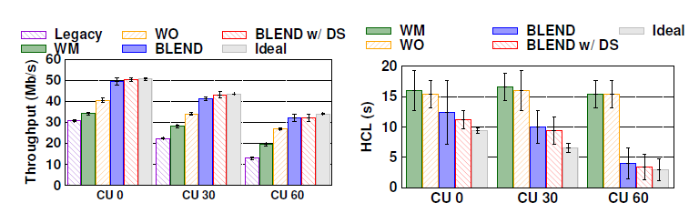
Performance Evaluation
Various channel utilization (CU)
  CU 0 means smartphone can utilize 100% of channel
Always show higher throughput
Handoff completion latency (HCL)
  Time difference between smartphone starts to move and finishes handoff
  Lower HCL represents the faster handoff
Notes:
We evaluate the performance of BLEND under various channel utilization. CU 0 means smartphone can utilize 100% of AP 1 channel. The BLEND shows always higher throughput compared with Legacy, WM, and WO. Because BLEND perform WiFi scanning adaptively and perform fast handoff. Throughput of BLEND w/ DS is slightly higher than BLEND thanks to direct scanning. As CU increase the overall throughput is decrease because smartphone cannot fully utilize the channel due to the background traffic. We define handoff completion latency (HCL), which represents difference time between smartphone starts to move and finishes its handoff. When smartphone cannot fully utilize the channel of AP1, it is advantageous to perform handoff to AP2 more quickly. Therefore, HCL decreases as CU increases in BLEND and BLEND w/ DS. However, WM and WO do not consider CU, HCL remains same. So, this means BLEND is adaptive to the change of environment.

Slide 14
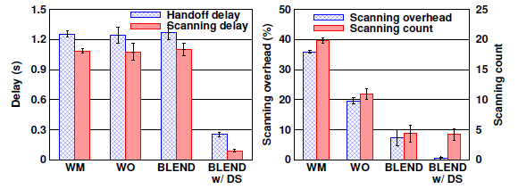
Performance Evaluation
Delay and overhead
  Handoff and scanning
Similar delay in one handoff procedure
Reduce overall scanning overhead (8%)
Notes:
We evaluate the BLEND in terms of delay and overhead. This delay is one component of HCL. Since WM, WO, and BLEND perform full channel scanning, scanning and handoff delay have no difference. However, BLEND w/ DS perform scanning only the channel of AP2, it significantly reduces the handoff and scanning delay significantly. This figure shows scanning overhead and count. Scanning overhead means the ratio of time consumed by scanning during 60s. WM and WO periodically perform WiFi scanning, they have large scanning overhead. However, BLEND and BLEND /w DS reduce the scanning overhead thanks to scanning decision module. The overall scanning overhead of BLEND is just 8%.

Slide 15
Concluding Remark
Observe and analyze the sticky client problem
Design a simple and practical handoff solution, called BLEND
  Realize WiFi handoff for smartphone with only application
Demonstrate the practicality, feasibility, and performance of BLEND through experiment in diverse environment
Notes:
Let me conclude my presentation. We observe and analyze the sticky client problem. To solve this problem, we design a very simple and practical handoff solution, called BLEND, which can operate with only application. Finally, our experiment results confirm that the practicality, feasibility, and performance of BLEND in diverse environment. This is the end of my talk, thank you for listening. Are there any questions?

Slide 16
Thank you!

Slide 17
Preliminary Experiment
Cause of the sticky client problem
Scanning operation
  Long WiFi scanning interval for fast handoff (maximum 10 min)
  Confirmed with experiment and Android source code
Handoff operation
  Repeat the same experiment
  Manually triggering WiFi scanning through application
  Smartphone never performs handoff
Need proper handoff mechanism for smartphone
Notes:
We want to find out the cause of the sticky client problem. We examine scanning operation and handoff operation of smartphone. We investigate the source code of Android Marshmallow. We find out that the WiFi scanning interval is too long to support fast WiFi handoff. The scanning interval is up to 10 min. We also double check this WiFi scanning interval through packet capture. As a result, WiFi scanning interval of smartphone is insufficient to support fast handoff on time and we think this is the reason for sticky client problem. So, we conduct the same experiment in previous slide to observe handoff operation of smartphone when scanning is triggered ceaselessly. However, triggering WiFi scanning cannot resolve the sticky client problem. That means smartphone has no handoff mechanism. Therefore, appropriate handoff operation for smartphone is absolutely necessary.

Slide 18
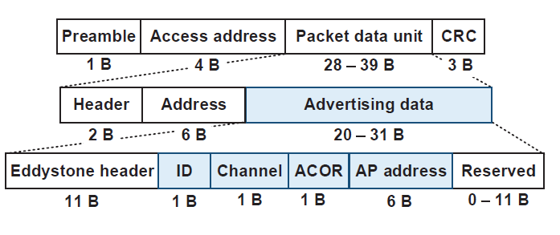

BLEND: Proposed Scheme
Proposed BLE advertising packet format
802.11n PHY rate and Rx sensitivity

Slide 19
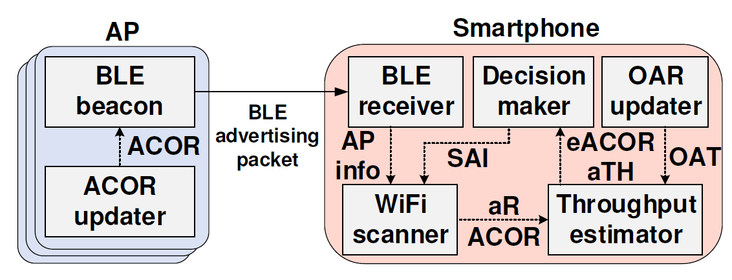
BLEND: Proposed Scheme
Overall architecture

Slide 20
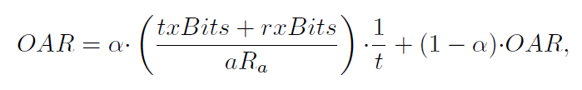


BLEND: Proposed Scheme
Ongoing airtime ratio
  Airtime consumed by transmission and reception of itself
Effective ACOR
Estimated throughput

Slide 21



BLEND: Proposed Scheme
Decision maker
  Handoff decision
  Scanning decision

Slide 22
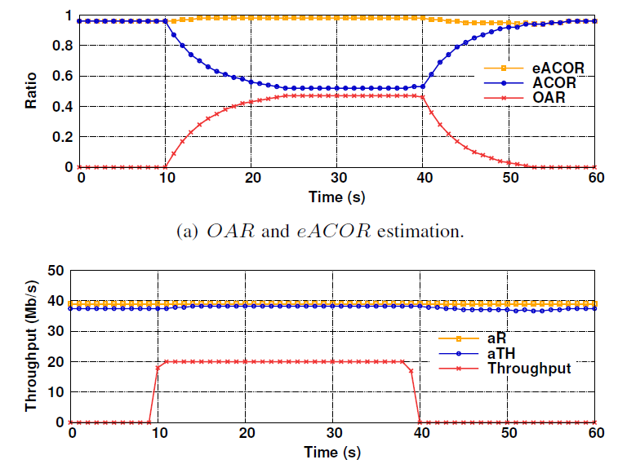
Verification
Validation of aTH estimation process

Slide 23
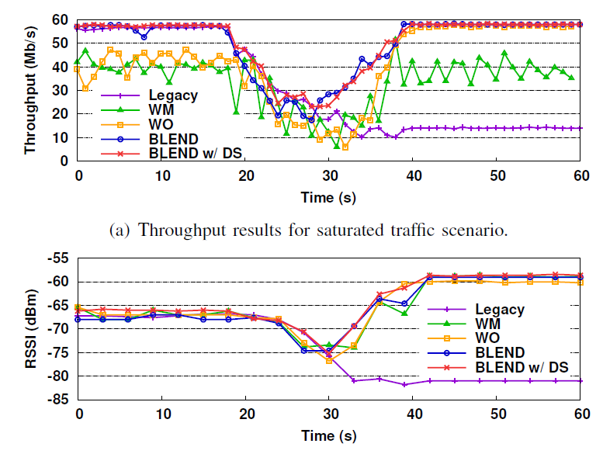
Performance Evaluation
No background traffic
Perform handoff to the candidate AP

Slide 24
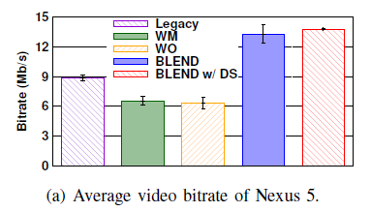
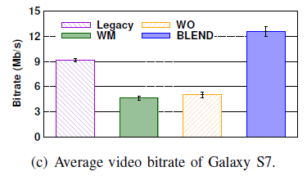
Performance Evaluation
Average video bitrate

Slide 25
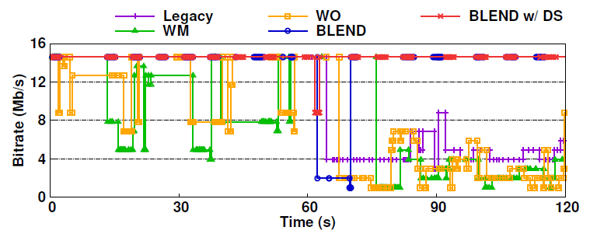
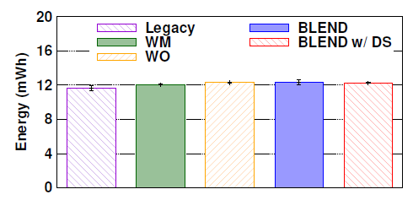
Performance Evaluation (Video Traffic)
Video streaming scenario
  Generate background traffic to AP 1
  Measure energy consumption
Quickly perform handoff according to environment
  104% and 111% higher video bitrate compared to WO and WM
Little energy consumption overhead (0.67 mWh)
Snapshot of video bitrate
Energy consumption

Slide 26
Previous Work
WiFi-based handoff
  Additional WiFi interface dedicated for WiFi scanning
  Multiple WiFi connection in link or transport layer
  Limitation
    Need hardware or device driver modification for smartphone
WPAN-aided discovery
  Find nearby AP through Zigbee or Bluetooth
    Find WiFi beacon signature by RSSI sampling
  Limitation
    Need additional hardware such as Zigbee dongle
    Can to operate with other Zigbee/Bluetooth connections
Notes:
To find signature of WiFi beacon

Slide 27
Why BLE?
Same operation through WiFi
  WiFi beacon contains information of AP
Limitation of WiFi only solution
  Should perform WiFi scanning in a periodic or event-driven manner
    Unnecessary WiFi scanning
  No direct root to deliver information of WiFi beacon to application
    No Android API
    Inevitable firmware modification
Not suited to our design philosophy
  Impractical and not feasible

