Slide 1
Rethinking Virtual Network Embedding in Reconfigurable Networks
Max Curran, Md. Shaifur Rahman, Himanshu Gupta and Vyas Sekar (CMU)

Slide 2
High-Level Summary
Reconfigurable data center (DC) networks
Can “reconfigure” network topology in real-time.
Virtual Network Embedding (VNE) problem: Embed VN request(s) onto a given host (DC) network.
Has been addressed in “static” networks.
Our work: VNE problem in reconfigurable networks (RNs).
RNs can reconfigure themselves to better accommodate the given VN requests.

Slide 3
Outline
Background
Reconfigurable DC networks (RNs)
Virtual network embedding (VNE) problem
VNE in RNs – Traditional traffic model.
VNE in RNs – Stochastic traffic model.
Results

Slide 4
Background: Reconfigurable Networks (RNs)
Traditional DC Networks: Wires and switches. Hence, “static”.
Reconfigurable Networks:
Network reconfigured in real-time to better handle prevailing traffic.
E.g., based on free-space optical (FSO) links connecting racks. FireFly (SIGCOMM 2014), ProjecTor (SIGCOMM 2016).
Notes:
Figures from PSU?

Slide 5
Background: Reconfigurable Networks (RNs)
Traditional DC Networks: Wires and Switches
Overprovisioned – to handle all possible (worst-case) traffic patterns at all times.

Slide 6
Background: Reconfigurable Networks (RNs)
ToR
switches
Rack
Reconfigurable Networks
Core replaced by “wireless steerable links”
Links controlled by a centralized controller

Slide 7
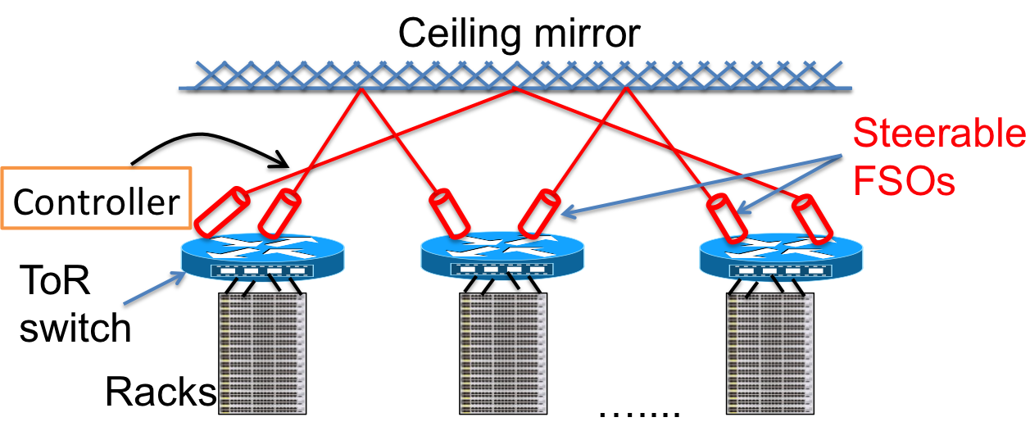
FSO-based RN (FireFly [Sigcomm-14])
Many (50+) steerable FSO links on each rack.
Links steered in real-time, based on traffic.
Near-optimal performance possible.
Key benefits: No wires, incremental expansion, perhaps lower cost.

Slide 8
Outline
Background
Reconfigurable DC networks (RNs)
Virtual network embedding (VNE) problem
VNE in RNs – Traditional traffic model.
VNE in RNs – Stochastic traffic model.
Results

Slide 9
Background: VN, and VN Embedding
Virtual Network (VN)
path
4 units
Embedding
½ units
Demands
Each VN also has a duration
Host Network

Slide 10
Background: (Online) VNE Problem
VN Requests
Reject Request
Embedding maintains total CPU
and bandwidth constraints
Host Network
Notes:
Overlap.

Slide 11
VNE Problem Complexity
(Online) VNE Problem is intractable.
Our intractability results:
Even for single-node VNs, the VNE problem is “in-approximable”
For single-node VNs with infinite durations, the VNE problem has a 2-competitive online algorithm.
Notes:
For single-node VNs, the VNE problem can be solved optimally (in exponential time) if re-embeddings are allowed and input-sequence restricted to accommodating sequences.

Slide 12
Outline
Background
Reconfigurable DC networks (RNs)
Virtual network embedding (VNE) problem
VNE in RNs – Traditional traffic model.
VNE in RNs – Stochastic traffic model.
Results

Slide 13
(Traditional) VNE Problem in RNs
Given a RN and a sequence of arriving VNs, for each arriving VN:
Accept (i.e., Reconfigure the RN, embed the VN),
OR
Reject the VN
such that the total revenue from accepted VNs is maximized.
Observation: No advantage in reconfiguring between VN arrivals.
Notes:
Accept or reject.

Slide 14
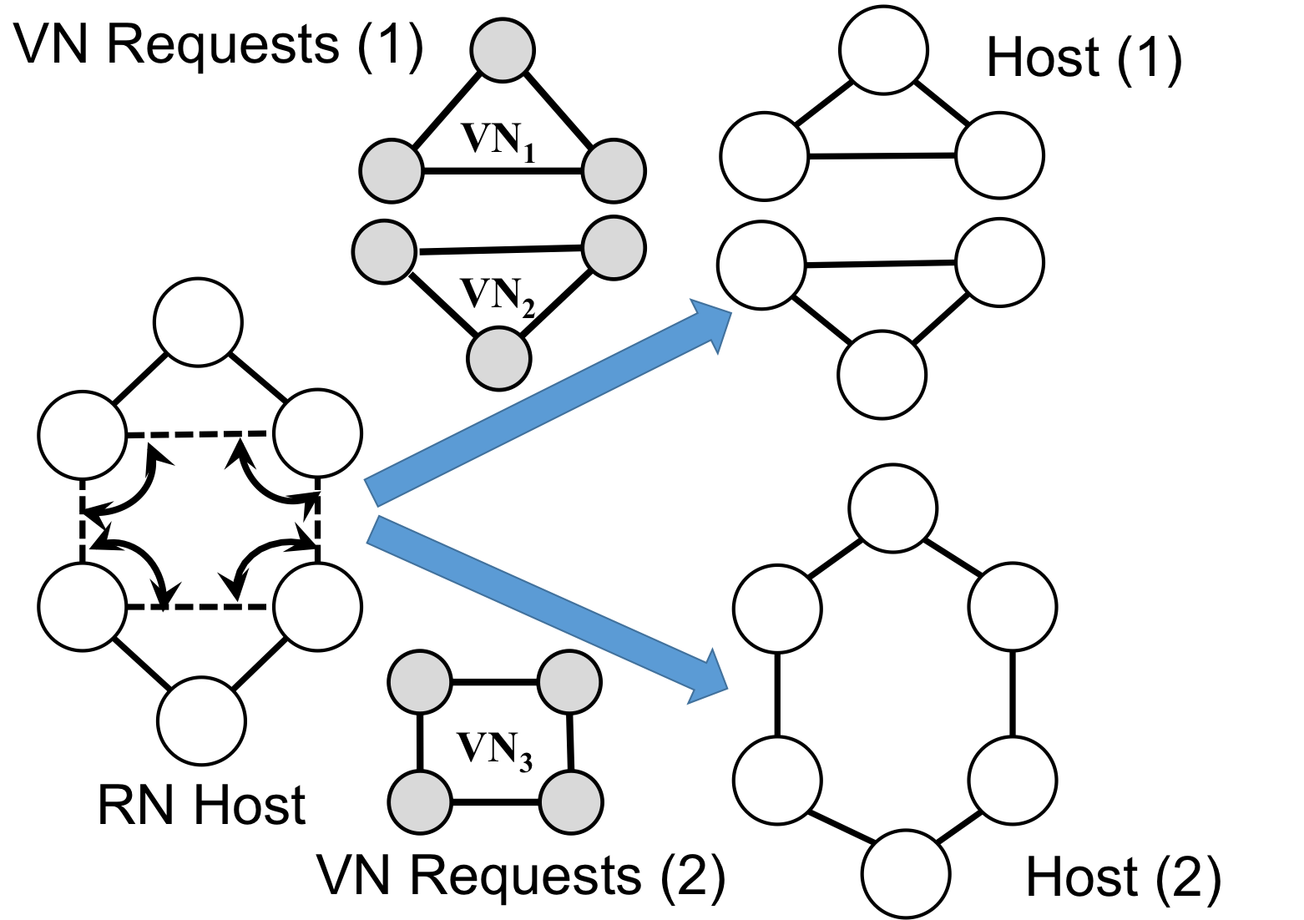
(Traditional) VNE Problem in RNs: Motivating Example
RN’s topology can be tailored to the incoming VN requests, and thus offer more revenue than comparable static networks.
Notes:
Fix the figure (shaifur). Add labels/annotations/animation.

Slide 15
(Traditional) VNE Problem in RNs: Algorithm
For a RN host (with embedded VNs) and a VN:
Rank host and VN nodes, based on available resources.
Traverse VN nodes in descending order of ranks over a tree in VN. For each VN node u:
Find the highest-ranked available host node.
Reconfigure the host and embed links of u.
Backtrack, if needed.
Similar to prior work for static host networks, except for red.
Notes:
What approach?

Slide 16
Outline
Background
Reconfigurable DC networks (RNs)
Virtual network embedding (VNE) problem
VNE in RNs – Traditional traffic model.
VNE in RNs – Stochastic traffic model.
Results

Slide 17
Outline
Background
Reconfigurable DC networks (RNs)
Virtual network embedding (VNE) problem
VNE in RNs – Traditional traffic model.
VNE in RNs – Stochastic traffic model
Stochastic Traffic Model
Runtime-binding of VN links’ embedding
Problem Formulation
Algorithm
Results
Notes:
Key contribution…

Slide 18
Stochastic Traffic Model
FIXED link bandwidth demands in the traditional model entail reserving a fixed bandwidth for VN’s duration. This leads to inefficient network utilization.
In reality, bandwidth demand is variable. Thus, we represent the link requirement as an “arrival rate” of flows.
Traditional VN
Stochastic VN
x units
of bandwidth
demand
Flow arrival
rate of y units

Slide 19
Runtime-Binding of VN Links
To better leverage the runtime reconfiguration capability of RNs, we also introduce runtime-binding (at real time) of VN links to substrate paths.
Each VN link is mapped to multiple links at embedding time, of which one is chosen at runtime based on network state.
Stochastic VN Link
Embedding with Runtime-Binding
Main Contribution
Notes:
Figure ......

Slide 20
Runtime-Binding of VN Links
To better leverage the runtime reconfiguration capability of RNs, we also introduce runtime-binding (at real time) of VN links to substrate paths.
Each VN link is mapped to multiple links at embedding time, of which one is chosen at runtime based on network state.
Stochastic VN Link
Embedding with Runtime-Binding
Chosen at runtime
Main Contribution
Notes:
OF LINKS Only.

Slide 21
(Stochastic) VNE Problem Formulation
Given a RN and a sequence of arriving stochastic VNs, for each arriving VN:
Accept (i.e., reconfigure the RN and embed the VN with runtime-binding),
OR
Reject the VN
such that the total revenue from accepted VNs is maximized.
In conjunction, we need to scheme to select runtime-binding of the VN links’ embedding.

Slide 22
(Stochastic) VNE Problem Algorithm
Algorithm: Same as before (rank nodes, reconfigure and embed with backtracking) except for
First, determine host link capacities in terms of arrival rates.
Ranking of nodes done differently.
Embedding a VN links entails mapping onto multiple paths with weights. (a) Short paths first. (b) Even distribution of weights, if possible.
The above works in tandem with an appropriate runtime scheme that appropriately chooses a runtime-binding of each embedded VN link.

Slide 23
Experiment Results
Flow-level simulations over large networks.
Real traffic-traces (VN requests from DeterLab).
Compared six useful combinations of algorithms for static/RNs, traditional/stochastic models, and arrival/run-time binding.
Key Observations:
Stochastic with runtime-binding performed the best across metrics.
Significant revenue advantage in reconfigurable networks compared to static networks.
For small networks, best algorithm performs 50-75% of optimal.
Notes:
Which of the combinations do not make sense….
METRICS…

Slide 24
Conclusions
Addressed VNE problem in reconfigurable networks.
Many open questions:
Runtime-binding of VN nodes? This will require efficient migration techniques.
Delaying VN requests.

