Slide 1
On the throughput limit of multi-hop wireless Networks with reconfigurable antennas
$${Yanjun Pan}_{}^{1} {Ming Li}_{}^{1} {Neng Fan}_{}^{1} {Yantian Hou}_{}^{2}$$
${}_{}^{1}$The University of Arizona,
Tucson, AZ, USA
${}_{}^{2}$Boise State University,
Boise, ID, USA
IEEE SECON 2018 – Hong Kong, China
Notes:
Hello everyone, my name is Yanjun, and I’m happy to present the joint work with my supervisor Dr. Li and his colleague Dr. Fan from UA, also Dr. Hou from Boise state university.

Slide 2
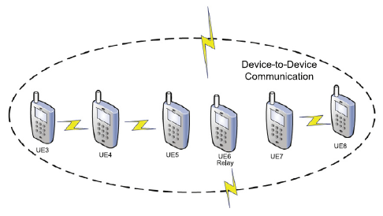
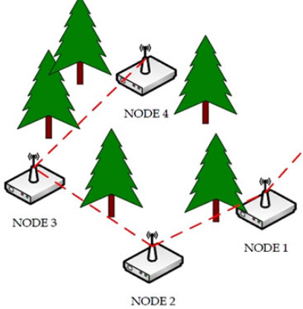
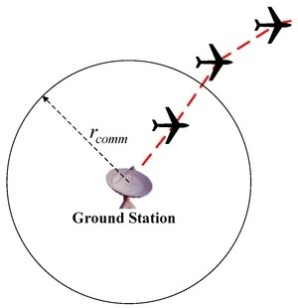
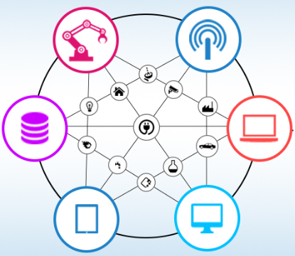
Multi-hop Wireless Networks (MWNs)
D2D networks, [Kar17]
Sensor networks, [Keshtgari11]
UAV system, [Zhu17]
Mesh network for IoTs, [Annie15]
Notes:
In recent years, multi-hop wireless networks are widely used in many scenarios. Typical applications include:
D2D networks, where devices can communicate directly through multi-hops. And UAV (Unmanned Aerial Vehicles) system, where UAVs can work as relay. Also multi-hop sensor networks for environment monitoring and mesh networks for the implementation of IoTs.

Slide 3
Multi-hop Wireless Networks (MWNs)
Challenges
unreliable links
D
large overhead
A
C
Slot 1
unreliable
Slot 2
Slot N
B
Slot N+1
Notes:
However, design a high performance MWNs has remained challenging due to two main reasons. The first reason is the unreliable wireless links caused by multi-path fading or mobility. For example, in this network, node A wants to send message to node C through path A-B-C. However, the link A-B is unreliable that makes the transmission from A to B failed in multiple slots. So node A will keep transmitting until B successfully receives message, which results in large overhead for the communication.

Slide 4
Multi-hop Wireless Networks (MWNs)
Challenges
interference
D
collision
A
C
B
Notes:
The second reason is the interference caused by the broadcast nature of wireless channels, in this network, when node C is receiving, no transmission is allowed at node D since it will cause collision at node C.

Slide 5
Existing Approaches
Link/Network Layer Mechanisms
Multipath routing, e.g. [Ganesan01],[Marina01], [Mueller04], etc.
Path diversity $→$ overall E2E delivery reliability
Opportunistic routing, e.g. [Biswas05],[Chachulski07],[Zeng08], etc.
Broadcast nature $→$ unreliable links
Network coding, e.g. [Li03],[Katti06,07,08], etc.
Broadcast nature & in-network processing $→$ turn interference into info.
None of them touch the fundamental characteristics of the wireless channel $→$ limited gains
Notes:
To cope with some of these challenges, various link/network layer mechanisms are proposed. For example, multipath routing uses the path diversity to increase the overall E2E data delivery reliability; opportunistic routing exploits the broadcast nature of the wireless channel to cope with unreliable links; and network coding also exploits the broadcast nature and adopts in-network processing to turn interference into useful information. However, none of these approaches touch the fundamental characteristics of the wireless channel itself, so results them in limited gains in practice.

Slide 6
Existing Approaches
Physical Layer Techniques
Transmission power & rate control, e.g. [Cruz03],[Lin04], [ElBatt04], [Krunz04],[Chiang05] etc.
Higher resource consumption, e.g. energy
MIMO, e.g. [Bhatia07],[Liu08],[Chu09],[Liu10],[Blough11] etc.
Spatial multiplexing & interference cancellation $→$ concurrent transmissions between multiple links possible
Extra hardware & energy consumption (multiple antennas)
Rich scattering might not be satisfied
Notes:
Besides, some approaches use physical layer techniques, such as transmission power and rate control to enhance the link capacity or reliability, but at the expense of higher resource consumption (e.g., energy). Also, MIMO techniques that enables Spatial multiplexing & interference cancellation make concurrent transmissions between multiple links possible. However, MIMO needs extra hardware & energy consumption due to multiple antennas. Besides, the rich scattering requirement for MIMO might bot be satisfied in practice.
rich scattering: a requisite for the channel matrix to have full rank

Slide 7
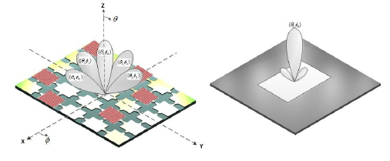
Reconfigurable antennas (RAs)
Dynamically Reconfigurable Properties
Changing structure electronically: swiftly reconfigure in terms of radiation pattern, polarization, and frequency, or combinations of them
Benefits
significant reduction in size: one RA can replace multiple traditional antennas
provide additional degrees of freedom
Existing work
shown to enhance link capacity and reliability, achieve better interference alignment and transmission scheduling, e.g. [Piazza10],[Kumar14], [Gou11], [Anderson14]
exploration of RAs has been limited to single-link or single-hop networks, e.g. [Gulati14], [Yllmaz15]
potential to enhance performance in MWNs has not been fully explored yet
Notes:
Under this context, reconfigurable antennas appear as a promising technology to solve the above challenges due to their dynamically reconfigurable properties. By changing its structure electronically, a reconfigurable antenna can swiftly reconfigure itself in terms of radiation pattern, polarization, and frequency, or combinations of them, as shown in the figure.
So one RA can replace multiple traditional antennas and we have significant reduction in antenna size. Also, the reconfigurable properties of RAs provide us additional degree of freedom for network optimization.
Existing works have shown that RAs are able to enhance link capacity and reliability, achieve better interference alignment and transmission scheduling. But the exploration of them has been limited to single-link or single-hop networks, and their potential to enhance performance in MWNs has not been fully explored yet.

Slide 8
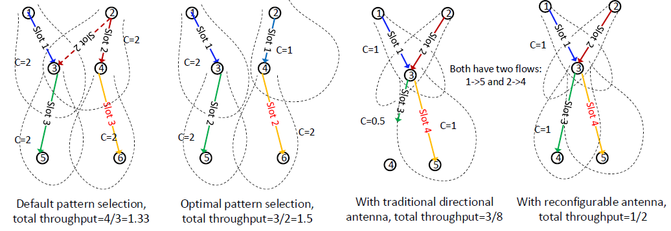
Reconfigurable antennas (RAs)
Benefits to MWNs
(a) Benefit of state diversity
(b) Benefit of fast state switching
Challenges
Large number of antenna configurations available at each node
Each antenna state associates with different transmission & interference range $→$ network topology become dynamic & change over time
Notes:
Indeed, applying RAs to MWNs provides us opportunities to optimize the throughput performance. For example, figure (a) shows the benefit of state diversity. In the left subfigure, node 2 uses the default state that maximizes the gain of link 2→4, but it also interferes with the 1→3 link. Thus nodes 1 and 2 have to transmit at separate time slots. In the right subfigure, optimal state selection is used such that node 2 adopts another state that has lower capacity for link 1→3, but now 1→3 and 2→4 can transmit simultaneously, which yields a higher E2E throughput.
Figure (b) shows the benefit of fast state switching. In the left subfigure, we use traditional directional antennas (DAs) with a fixed beam, since initially there is one flow (1→ 5), the DA beam at node 3 is optimized to point toward node 5; but later when the 2→4 flow arrives, link 3→4’s capacity is degraded by half due to fixed beam direction at node 3. In the right subfigure, while using RAs, node 3’s transmitting state can be quickly adjusted such that 3→4 link’s capacity remains the same, which again enhances total E2E throughput.
However, it is difficult for us to quantify the gains of RAs for a general large-scale MWNs. First, the large number of antenna configurations available at each node makes the number of state combinations among all the nodes very large.
And more importantly, now each antenna state associates with different transmission & interference range, which makes the network topology become dynamic and can change over time.

Slide 9
Interference & Antenna Model
For state-link pair $\left(i,j,u,v\right)$ with transmission set $𝒯_{i,u}$, interference set $ℐ_{i,u}$:
Node $j$ under state $v$ is in $𝒯_{i,u}$ if $P_{r}\left(j\right)>P_{T}$, $P_{T}:$ detection threshold
Node $j$ under state $v$ is in $ℐ_{i,u}$ if $P_{r}\left(j\right)>P_{I}$, $P_{I}:$ interference threshold
Receiver $j$’s received power is $P_{r}\left(j\right)=P_{t}\left(i\right)L_{i,j}f(u,v)$
$P_{t}\left(i\right)$: $i$’s transmission power, $L_{i,j}$: path loss
$f(u,v)$: impacts of antenna’s states on the channel
only pattern reconfigurable: $f\left(u,v\right)={G_{T}}_{i}\left(u,θ_{i,j}\right)⋅{G_{R}}_{j}\left(v,θ_{i,j}\right)$
only polarization reconfigurable & both polarizations are linear: $f\left(u,v\right)=G_{T_{i}}G_{R_{j}}\cos^{2}{φ}$
only frequency reconfigurable:$f\left(u,v\right)=G_{T_{i}}G_{R_{j}}$, if $u\&v$ have the same frequency, otherwise, $f\left(u,v\right)=0$
Supports arbitrary types of antennas
Notes:
In this work we apply RAs to MWNs and jointly optimize routing, scheduling and antenna state selection. Thus in our interference model, we need to consider a node as well as its antenna state simultaneously.
So for transmitter I under state u, the receiver j under state v is in its transmission set if the received power at j exceeds the detection threshold. Similarly, we can get the interference set with interference threshold.
Then the received power at receiver j will given by the product of three terms, the first term is … the second term is … and the last term is a function that reflects the impacts …, the function will be in different form under different antenna types. And we can see that our antenna model supports …

Slide 10
Interference & Antenna Model
State-link pairs $\left(i,j,u,v\right)$ and $\left(i′,j′,u′,v′\right)$ cannot transmit simultaneously if they interfere with each other
Scenarios cause interference:
A node selects more than one state at a certain time
A node transmits to/receives from multiple nodes at a certain time
A node transmits & receives at the same time
The receiver of one state-link pair is interfered by another state-link pair’s transmitter
Notes:
Then two state-link pairs cannot ….
Here we list the scenarios that will cause interference and we will give examples of them later.

Slide 11
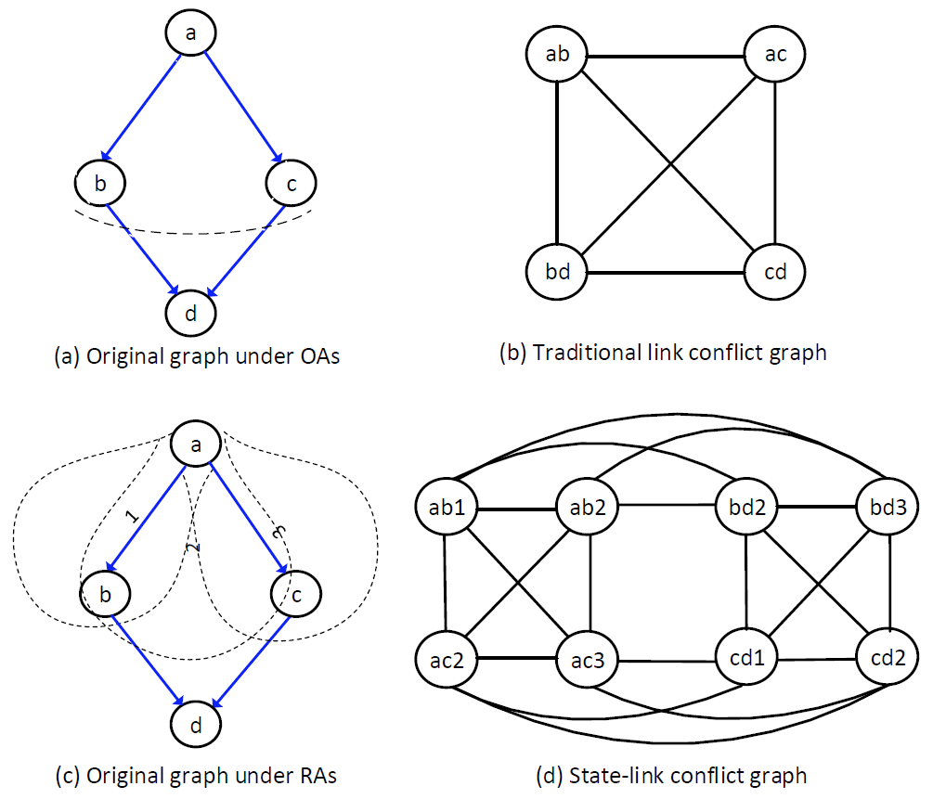
Antenna State-Link Conflict Graph
transmitting antenna pattern reconfigurability only
Captures relations between antenna state selection, link coverage, and interference
Reduces the number of combinations in the network (state-node $→$ state-link)
Conflict Graph | Independent Sets
Traditional | {ab},{bd},{ac},{cd}
State-link | {ab1,cd1},{ab1,cd2},{ab2,cd1},{ab2,cd2},{ac2,bd2},{ac2,bd3},{ac3,bd2},{ac3,bd3}
Notes:
With above antenna & interference model we can get our state-link conflict graph model. Here is an example. To simplify, we consider transmitting antenna pattern reconfigurability only. The original four-node network graph under OAs is shown in Figure (a). Figure (b) shows the traditional link-based conflict graph using OAs, where there are four ISs and each of them only contains one link, which means only one link can transmit at a time.
With RAs, the original network graph is shown in Figure (c), where each node’s RA has the same set of three transmitting states indexed by {1, 2, 3}. Its corresponding conflict graph is shown in Figure (d). Here,
Ab1 & ab2 conflict with each other because a node can only select one antenna state at a certain time.
Ab2 &bd2 conflict with each other because a node cannot transmit and receive at the same time.
Bd3 &cd2 conflict with each other because a node cannot transmit to or receiver from multiple nodes at the same time.
With previous interference conditions, we can get the whole state-link conflict graph as in Fig. (d).
Now we can see that we get eight new ISs, where two-link simultaneous transmissions become possible.
From the results, we can see that the state-link conflict can capture …

Slide 12
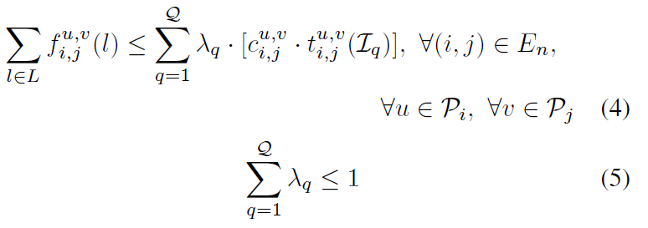
Max-Flow Based Optimization Framework
Scheduling Constraints:
=1, if link $(i,j)$ under state $(u,v)$ is in independent set $ℐ_{q}$
=0, otherwise
Flow rate of session $l$ over link $(i,j)$ under state $(u,v)$
Capacity of link $(i,j)$ under state $(u,v)$
Set of all the independent sets in the conflict graph
Time-share that independent set $ℐ_{q}$ is scheduled
Notes:
With our state-link conflict graph, we can formulate our throughput optimization problem as follows. Suppose that we can list all the ISs in the conflict graph as set Q. Then we have the following scheduling constraints. Here variable f is … , variable lambda is …, parameter c is…, and parameter t equals to one if …, Constraint (4) is the capacity constraint which means that the total flow over a state-link pair cannot exceed the capacity it scheduled. And constraint (5) means the summation of time-shares cannot exceed 1.

Slide 13
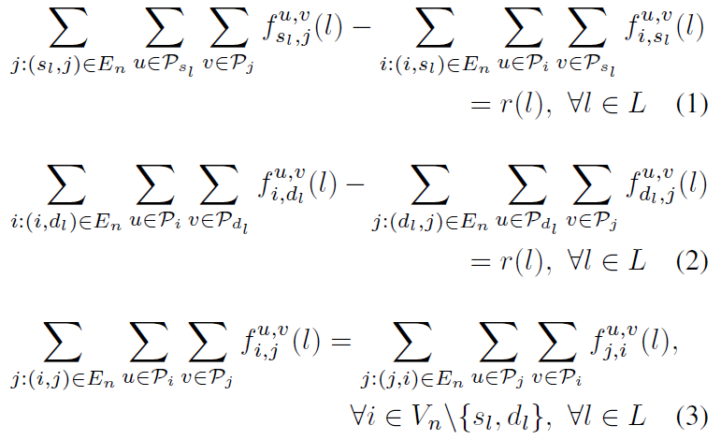
Max-Flow Based Optimization Framework
Routing Constraints (flow balance):
Total flow rate of session $l$
Notes:
Denote variable r as … Then we have following routing constraints, which are standard flow balance constraints in the max-flow problem. That is the aggregate flow rate of a session is flows generated from the source intended for the destination. And for any intermediate nodes, overall incoming flows must balance with overall outgoing flows.

Slide 14
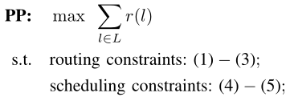
Max-Flow Based Optimization Framework
Primal Problem:
Challenges:
Find all the independent sets in a graph is NP-hard
Cannot solve PP directly
Notes:
Based on above constraints, we get the following max-flow based formulation and we call it primal problem. This problem cannot be solved directly since it assumes the knowledge of all the independent sets in the conflict graph, and find this set is NP-hard.

Slide 15
Decomposition: Column Generation Based Approach
In large-scale linear programming problems, most of the variables are non-basic and assumed to be zero in the optimal solution when solving the problem
Only a subset of variables need to be considered
Generate only the variables which have the potential to improve the objective function
In our case: most of independents sets are not activated
Notes:
So next we use column generation decomposition approach to solve our problem. The basic idea behind column generation is that …
Column generation is suitable for our problem because in our case …

Slide 16
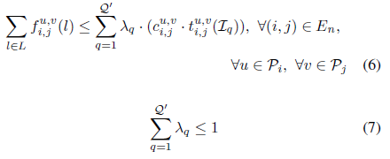
Decomposition: Column Generation Based Approach
Starting with a subset of all the independent sets $𝒬′$, scheduling constraints are restricted to:
Restricted master problem:
Linear programming, can be solved optimally in polynomial time when given $𝒬′$
Notes:
In our problem, to use column generation, we start with a subset of Q which is denoted as Q’, then scheduling constraints can be restricted to the following forms, here we simply replace the whole set Q with its subset Q’. Then we get the following restricted master problem. Note that this master problem is a linear programming problem, which can be solved optimally in polynomial time when Q’ is given. And the simplest way to get Q’ is to take every state-link pair in the conflict graph as an IS.

Slide 17
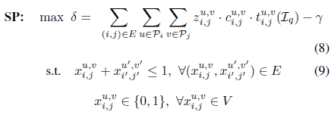
Decomposition: Column Generation Based Approach
Subproblem: find a new independent set
Optimal: $δ^{∗}≤0$
Dual solution of constraint (6)
Dual solution of constraint (7)
=1, if link $(i,j)$ under state $(u,v)$ is in independent set $ℐ_{q}$
=0, otherwise
$⇔$maximum weight independent set problem, NP-hard
Notes:
Then here occurs the subproblem which finds a new independent set that is potential to improve the objective. Here variables z and gamma are dual solutions of restricted scheduling constraints, and x indicates whether a state-link pair is in the IS Iq. And the objective is obtained from the definition of the reduced price in column generation algorithm.
Then our problem can be solved in this way: first we solve master problem with the simplest subset Q’, then we get the dual solutions for subproblem. After solving the subproblem we get a new independent set, we add this set to the subset Q’ and solve RMP and subproblem iteratively. The iteration ends when … However, we notice that the subproblem is a maximum weight independent set problem indeed, which is also NP-hard.

Slide 18
Heuristic & Optimal Algorithms
Conflict-Graph Pruning Based Heuristic Algorithm (CPH)
Basic idea: prune the original conflict graph $→$ reduce the size of the input to the column generation based solution
Step 1: find link-disjoint paths
For each session: set $c_{ij}=1$
Max-flow alg.
Aggregate all
Link-disjoint paths
Conflict graph $G_{c }^{′}=(V^{′},E′)$
Step 2: select top-k antenna states for each link
Why link-disjoint paths?
preliminary results: most of activated state-link pairs are link-disjoint
reduce No. of links
For each $x_{ij}^{uv}∈V′$,
$${{(c}_{ij}^{uv})}^{′}=c_{ij}^{uv}/N(x_{ij}^{uv})$$
For each $\left(i,j\right)∈G_{c}^{′}$, sort ${{(c}_{ij}^{uv})}^{′}$ with non-increasing order
Reserve $x_{ij}^{uv}$ with largest top k $(c_{ij}^{uv})′$
Aggregate all
Conflict graph $G_{c }^{′′}=(V^{′′},E′′)$
Notes:
To solve our column generation based approach more efficiently, we first proposed a Conflict-Graph Pruning Based Heuristic Algorithm, the basic idea is to prune the original conflict graph so as to reduce the size of the input to the column generation based solution. There are two steps in this alg. The first step is to …
Here we choose to use link-disjoint paths instead of other methods because …
Next, based on the pruned conflict graph Gc’ from step 1, we update the capacity for each state-link pair and select the top-k of them. After this step we will get our final pruned conflict graph. And then we implement column generation technique based on this final conflict graph by starting with the simplest subset Q’.

Slide 19
Heuristic & Optimal Algorithms
Optimal Algorithm (RedOpt)
Start with the set of independent sets obtained by CPH alg.
Solve column generation structure based on the original conflict graph
The running time is largely reduced comparing with original column generation based approach
Notes:
Based on above heuristic problem, we propose an optimal algorithm. That is we start with …
Note that, the running time for this opt. alg. is largely reduced comparing with original column generation based approach because we start with good independent sets founded by the heuristic alg.

Slide 20
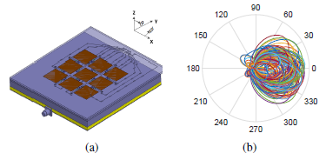
Evaluation Results
A Case Study
Configuration
20 nodes
60m*60m area
Transmitting antenna state reconfigurability only
At most 100 antenna states
2 sessions: 4 $→$ 18, 15 $→$ 2
K=10
Platform
MATLAB with CPLEX 12.7.1
Windows machine with 32GB RAM, Intel Core CPU 3.6GHz
Notes:
For evaluation results, first we consider a case study where 20 nodes …
And here we show the RA we use, it has 12 switches which gives us 1024 antenna state, but here we consider 100 antenna states at most.

Slide 21
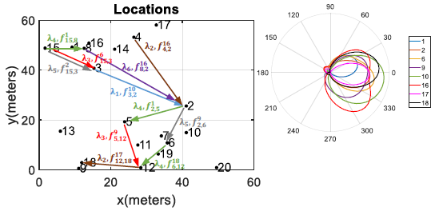
Evaluation Results
A Case Study
4$→$18,15$→$2
Node 15: State diversity & swift pattern switching
Notes:
In this figure we show the optimal routing, scheduling and antenna state selection results under 20 antenna states. Here the state-link pairs with the same color are in the same IS. From the result we can see that node 15 utilizes different antenna states for link 15-3 in different independent sets, which shows the state diversity and swift pattern switching benefits of RA.

Slide 22
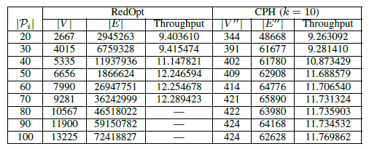
Evaluation Results
A Case Study
Increase dramatically
Increase much slower
Memory overflow: no solution
Lower bound
Small gap $→$ CPH might be able to approximate to the optimal solution with high accuracy
Notes:
When we look into the details of this case study, first we notice that …

Slide 23
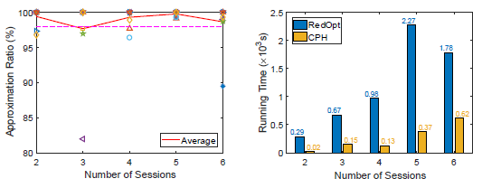
Evaluation Results
Performance of Heuristic & Optimal Algorithms
Impact of No. of sessions
Randomly generate sessions, 10 scenarios for each session setting
No. of antenna states = 40
High approximation accuracy for CPH Alg.
Notes:
Next we study the Impact of No. of sessions …

Slide 24
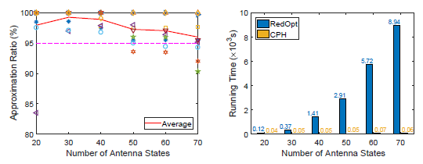
Evaluation Results
Performance of Heuristic & Optimal Algorithms
Impact of No. of antenna states
Fairness issues $→$ select 10 scenarios that both sessions can be activated
No. of sessions = 2
CPH performs better in random session cases $→$ good performance in general
Notes:
Then we consider …
In this scenario, the heuristic alg performs worse than previous case. That is our heuristic alg. could have good performance in general.

Slide 25
Conclusion & Future Work
Proposed a novel state-link conflict graph model capturing the dynamic antenna state-link relations
Developed a tractable max-flow based methodology to derive throughput limits of MWNs with RAs
Proposed a conflict-graph pruning based heuristic algorithm that further accelerates the optimal solution
Future work: consider fairness issues and unreliable links/channels, design efficient approximation/distributed algorithms
Notes:
In conclusion, …
And the heuristic itself can also be used as an approximation algorithm
And for the future work …

Slide 26
THANK YOU FOR YOUR ATTENTION

Slide 27
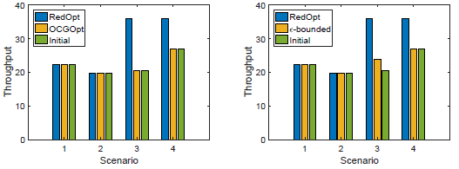
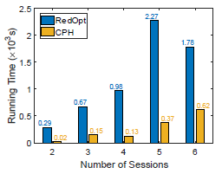
Evaluation Results
Comparison
OCGOpt: original column generation based optimal solution
$ε$-bounded approximation algorithm, [Li15]
$ε=5\%$
Select 4 scenarios
Notes:
Finally, we compare our optimal algorithm with …

Slide 28
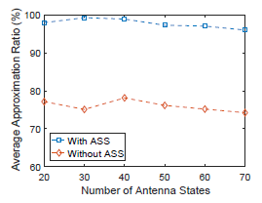
Evaluation Results
Performance of Heuristic & Optimal Algorithms
Antenna state selection benefits
Simulate the joint routing and scheduling optimization only: predetermine to the pattern with highest signal power
Aver. approximation ratio reduces about 20% without opt. antenna state selection
Notes:
Besides, we also implement a simulation to show…

Slide 29
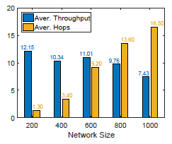
Evaluation Results
Performance of Heuristic & Optimal Algorithms
Scalability
Network density: 10/(200*200)
Increase side length of the square from 200 to 1000
2 sessions
20 antenna states
Randomly generate 10 scenarios each
More hops
Decrease of the throughput is graceful
Less throughput
Directivity & Coverage of RA
Notes:
To the scalability of our algs, we …

